Slide 1

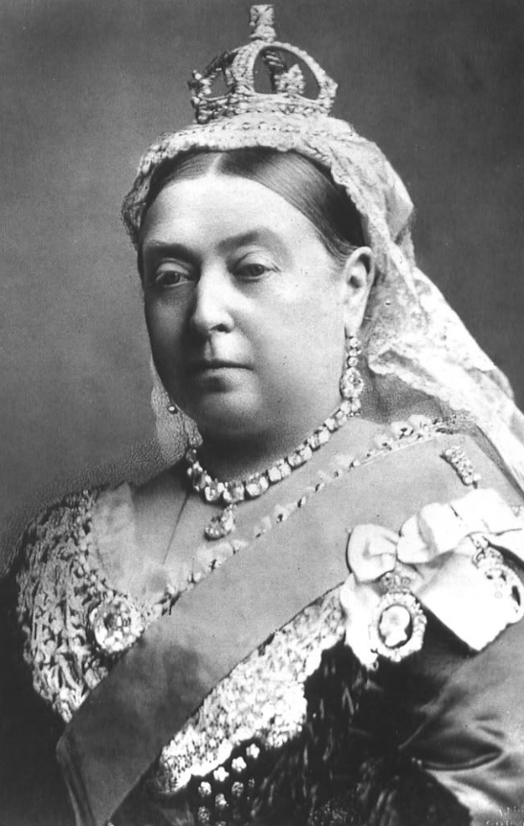








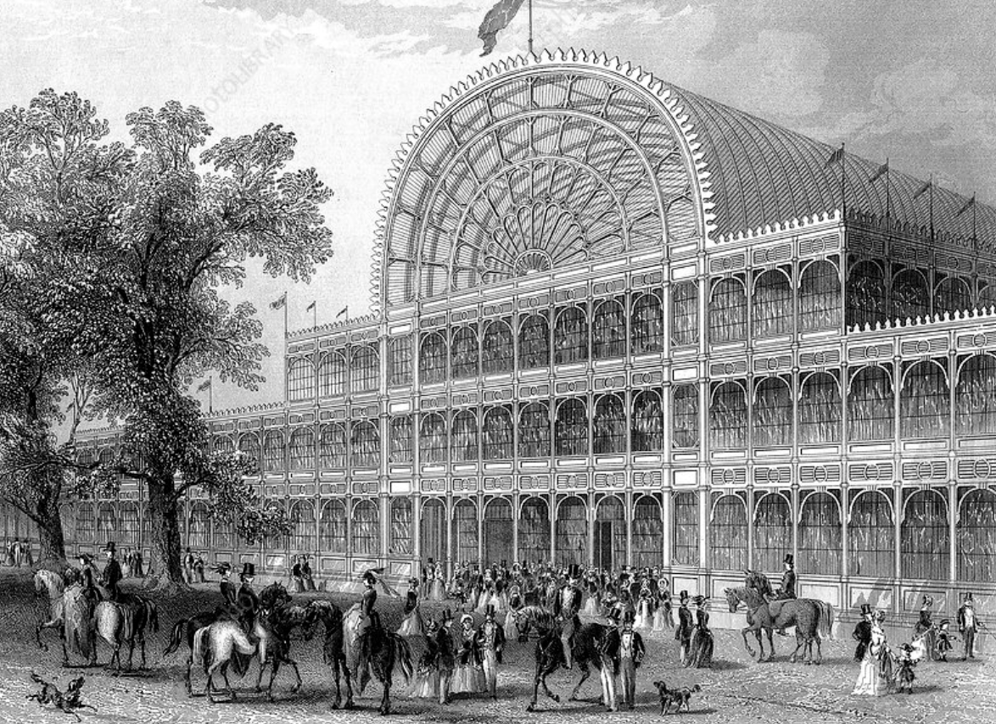
Year 6 Knowledge Organiser – Unit 2 History Were the Victorian times a Dark Age or a Golden Age?
KQ1: What was the industrial revolution?
The Industrial Revolution = vast changes to the world that began in Britain and that accelerated the creation of the modern world as we understand it. Shift to where most people worked on farms and/or made things by hand to one where things made in factories. Start of the Industrial Revolution = 15% of people in Britain lived in towns and cities. 1900 = 85% lived in towns and cities. Science increasingly influenced new technologies Factories produced a lot of air pollution = health problems and changed the way that many towns and cities looked. Children were often sent to work long hours in factories and mines.
KQ2: What characterises the Victorian era? 1837-1901
Pace of technological change intensified. Britain was transformed into the world’s most powerful industrial nation. Britain had the world’s biggest empire. By 1901, ¼ world’s people. Lives of children in Victorian Britain differed greatly depending on how wealthy their family was. Richer children were usually educated. 1880 law was passed making education mandatory for all children. Era was an age of great change and advancement in science, the arts, politics and social reform.
HISTORICAL CONTEXT
Romans
AD 43
Saxons
AD 450
Vikings
AD 793
Normans
1066
Tudors
1485
KQ3: Why was the steam engine so important?
Steam engines helped to power the Industrial revolution. Boosted the economy by speeding up trade. UK became the centre of the train-building industry.
Victorians
1837
KQ4: How did the railways change life in Britain?
Railways completely transformed life in Britain and the landscape of Britain. People were able to quickly, easily, and cheaply. Communication: railways made communication quicker. Industry and employment: thousands of people were employed. The economy: it cost less money to transport raw materials around the country. Urban development: new towns grew up around some important junctions. Food and farming: fresh fish could be delivered to towns and cities. Sport: teams could travel around the country to compete. Education: children from the country could travel to school in the towns.
KQ5: What was the Great Exhibition and why was it significant?
Britain was known as ‘the workshop of the world’. The Great Exhibition took place in 1851 in Hyde Park, London and lasted 6 months. Its purpose was to make clear to the world Britain’s role as an industrial leader. It was the world’s first international exhibition. The centrepiece of the Exhibition was the ‘Crystal Palace’.
WWII
1939
KQ6: How has Victorian invention affected my life today?
Victorian invention and innovation took place in industry, engineering, science, medicine, education, public health, leisure and lifestyle. Changes were not just physical; new ideas were changing the social and political landscape. Britain today is full of reminders of the Victorian era: e.g. houses, railway stations, bridges, seaside piers, public libraries, the telephone and the steam engine.

