Slide 1



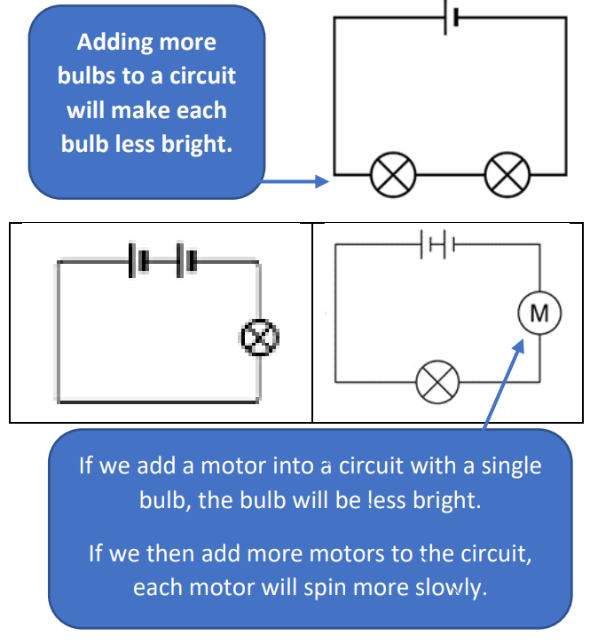
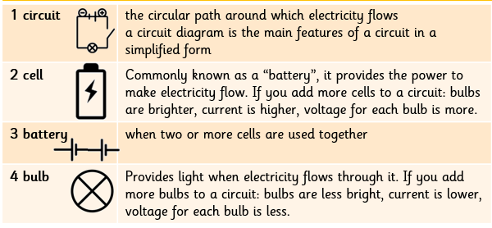
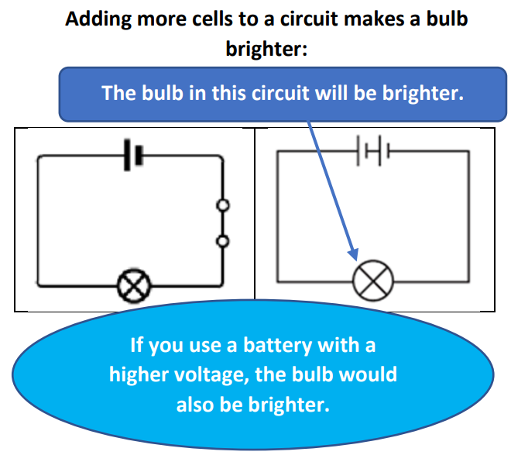
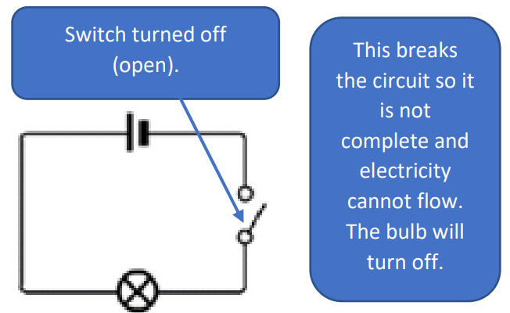
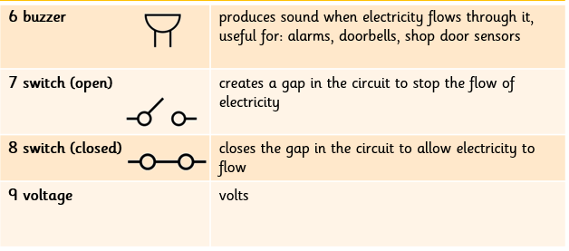

| Year 6 Knowledge Organiser – Unit 3 Science |
Electricity.
KQ1: What do I already know about energy and materials?
An object is made from/of a material. Metal is a material from which objects can be made. Matter (stuff) is made from tiny building blocks. Energy comes in different forms and can be neither created nor destroyed, only changed from one form to another..
KQ2: What is electricity?
Electrical energy is one of many forms of energy. Static electricity is an imbalance of charged particles on a material; it does not operate by flowing around a complete circuit. Current electricity is the flow of charged particles called electrons around a circuit. Current electricity is the form of electricity that we use in our lives in lights, computers, televisions, etc. Cells, batteries and the mains are all sources of electrical energy.
KQ3:What is an electrical conductor?
Electrical current flows well through some materials, called electrical conductors, and poorly through other materials, called electrical insulators. Conductors have free electrons (tiny, negatively charged particles) and that when electrical current flows around a conductor the electrons move. Electrical conductivity (how well a material conducts electricity) is an example of a property. Metals are good electrical conductors
KQ4: What do I need to create an electrical circuit?
KQ5: How do circuit diagrams help me to know whether something will work or not?
KQ6: How does changing the voltage running through a circuit affect what happens in it?
Voltage is a measure of the power of a cell to produce electricity; it is a measure of the ‘push’ of electric current, not the size of the electric current. As the number and voltage of cells in a circuit increases, the brightness of a bulb or the volume of a buzzer will increase (though too high a voltage may ‘blow’ the bulb or buzzer).

