Slide 1

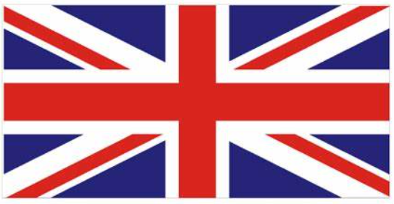
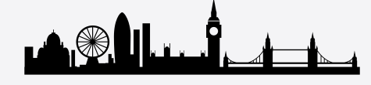
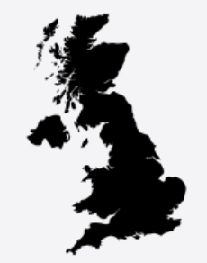

| Year 6 Knowledge Organiser – Unit 3 Geography |
Region of the UK: Is everywhere the same in the UK?
KQ1: How can 6-figure grid references be used to increase our knowledge of an area?
Landscape features and places (both human and physical) can be located on an Ordnance Survey map through the use of grid references and grid squares. The ‘Eastings’ and ‘Northings’ are the numbers around the edge of an OS map. To pinpoint a place, you take the Eastings number first, then the Northing (along the corridor and up the stairs). You also need a two-letter code (e.g., SK 2607) Six-figure grid references enable more accurate readings, as two more figures give the exact location within the grid square identified through the four-figure grid reference.
KQ2: What is the ‘picture’ of the UK?
The UK stands for the United Kingdom. It is called this because it is made up of four smaller countries: England, Northern Ireland, Scotland and Wales. England, Scotland and Wales are located on the island of Great Britain. Northern Ireland and the Republic of Ireland are on the island of Ireland. The UK is surrounded by water: The English Channel (between England and France) The Irish Sea (between England and Wales and Northern Ireland and Ireland) The North Sea (between Great Britain, Norway and Denmark). Each of the four countries of the UK has its own capital city. Belfast is the capital city of Northern Ireland. Cardiff is the capital city of Wales. Edinburgh is the capital city of Scotland. London is the capital city of England. When we visit the capital cities, we see different landmarks in each one.
KQ3: Why is Birmingham/ Blackpool the city it is today?
Blackpool is located in Northwest England, in the county of Lancashire. Birmingham is located the centre of the West Midlands region of England, it is further south than Blackpool. Birmingham: it was once known as the 'City of a Thousand Trades' and was a world leader in the production of pens, buckles, buttons, jewellery and guns. Over the last 30 years, the city’s focus has shifted from the manufacturing industry to the service industry.
KQ4: How has the population of London changed? What does it mean to be British?
London is the capital and largest city of England and the United Kingdom, with a population of just under 9 million. It stands on the River Thames in south-east England. Between the last two censuses (held in 2011 and 2021), the population of the City of London increased by 16.4%, from around 7,400 in 2011 to around 8,600 in 2021.This means the City of London's population saw the third-largest percentage increase in London. London as an example of multicultural Britain; the values and processes of democracy; rule of law in safeguarding citizens; tolerance within society and freedom of speech.
Blackpool
Birmingham

