Slide 1

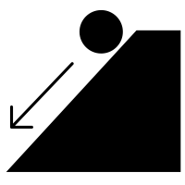


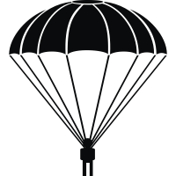
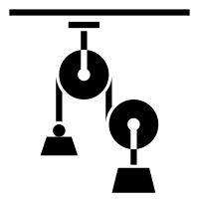

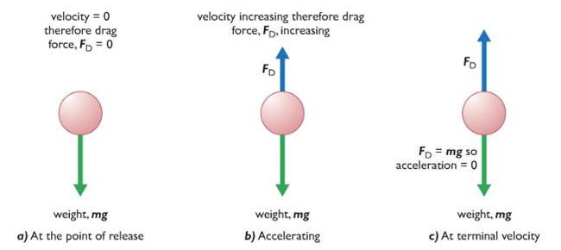
| Year 5 Knowledge Organiser – Unit 2 Science |
What is a force?
KQ1: What is a force?
A force can be thought of as a push or a pull. As objects move across a surface there is friction when they rub against each other and that sometimes this friction is larger or smaller. Applying forces to objects can change their shape. The roughness of a material is an example of a property. There are three types of contact force: impact forces (when two surfaces collide), frictional forces (when two surfaces are already in contact) and strain forces (when an elastic material is stretched or squashed). Objects move differently on rough and smooth surfaces; objects resist movement more on rough surfaces because there is higher friction as the object moves.
KQ2: How are forces measured?
A force is measured in a unit called Newtons, named after a British scientist called Sir Isaac Newton who discovered lots about gravity and how planets move. Newton was undoubtedly one of the greatest scientists who ever lived, a genius who discovered a great deal about forces, including gravity, mathematics and light. Pull forces can be measured using a device called a force meter. The amount of matter (stuff) in an object is its mass.
KQ3: What is gravity and how does it act between objects?
Gravity is a force that acts between all objects in the universe, but that it acts much more strongly between objects that have more mass and that are close together. Unsupported objects are pulled towards the Earth by the force of gravity. Acceleration is a change in speed and that unbalanced forces acting on an object cause it to accelerate.
KQ4: What is air resistance and how does it act on objects?
Air resistance is a force felt by an object as it moves through the air; it is caused by the object bumping into the gas particles that make up air. A falling object will accelerate until its air resistance matches the gravitational force pulling it down; at this point, the object will continue to move at this speed (called its terminal velocity). A parachute’s shape increases the air resistance that a falling object experiences, giving it a much lower terminal velocity. Water resistance is a force felt by an object as it moves through water; it is caused by the object bumping into the water particles. The shape of an object determines how much air resistance or water resistance it experience.
KQ5: How are forces drawn on a diagram?
A force diagram with arrows representing the different forces acting on an object.
KQ6: How do pulleys and gears move?
A lever is a rigid length pivoting around a fulcrum. A pulley is a wheel with a fulcrum that supports a moving cable or belt. A gear is a rotating wheel with cut teeth that mesh with the teeth of another gear so that turning one gear turns an adjacent gear in the opposite direction. Gears, levers and pulleys are simple machines that are used to allow a smaller force to have a greater effect; they do this by moving a smaller force over a longer distance at one end of the machine, which the machine turns into a larger forcer over a small distance at the other end.

