Slide 1








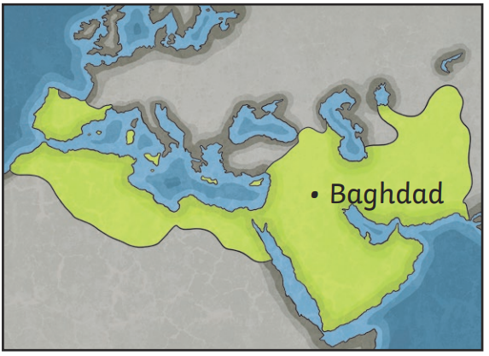
| Year 5 Knowledge Organiser – Unit 3 History |
Golden Age of Islam: Which Early Islamic achievements have affected our lives today?
HISTORICAL CONTEXT
KQ1: What is Islam and how did it begin?
Muslims believe that Muhammad (born in 570) received revelations from God between 610 and 632; he gained followers, some of whom memorised the revelations and wrote them down. Muhammad believed and stated that all people were equal before God, a radical message that rulers of the time considered to be dangerous; Muhammad’s message of submission to one God, expectation of imminent last judgement and the importance of caring for those in need won followers; following years of military conflict between new followers of Islam and those previously in charge, Muhammad united the tribes of the Arabian peninsula before his death in 632. When Muhammad died, Muslims struggled to agree who should be the next caliph. The first four caliphs appointed after this time came to represent an age of ‘pure Islam’. When the last, Ali, was assassinated in AD 661, the Umayyad dynasty of caliphs took over for nearly a century. After that began the reign of the Abbasid caliphs. Abbasid caliphate founded the city of Baghdad in 762; this city would go on to be the largest and most scientifically advanced in the world.
KQ3: What was it like to live in Baghdad during that time?
Workers came from every city in the empire to build the city and that the network of canals supplied water to farms and allowed food and other goods to be brought into the city by boat. They had a range of jobs like, jeweller, butcher, baker, musician, merchants buying cloth. Ships went to China, selling glass and date honey, returning with ceramics. In Baghdad, a building translates into English as ‘House of Wisdom’; historians disagree as to the exact function of this place; there is very little written evidence about the place; historical sources suggest that it was at least a place where books were translated and stored and that great thinkers like al-Kwarizmi worked there. Some believed that the House of Wisdom was likely to have been a place where great thinkers studied and made discoveries; other historians think it is more sensible to not make these guesses.
Celts
800BC
Romans
AD 43
Saxons
AD 450
Early Islamic civilisation
AD 750
Normans
1066
KQ4. How was the influence of Islamic civilisation able to spread so far, so quickly?
Baghdad became a key global centre of trade along the ‘Silk Routes’ (often known as the ‘Silk Road’) a network of land and sea routes that connected the civilisations of the East and West; the Silk Routes allowed trade of many luxury goods, and the routes get their name from the silk that was bought from China and travelled westwards.
Tudors
1485
Victorians
1837
KQ2: How did Baghdad develop into a significant city?
Baghdad is located in the heart of Mesopotamia, beside the Tigris river; like the ancient civilisations, the location on a river floodplain ensured access to water for agriculture (through irrigation) and for drinking. Baghdad was designed and built between and 762 and 766 on the orders of the Abbasid caliph al-Mansur to be the official residence of his court; it was a round city, in tribute to the work of the Greek mathematician Euclid who al-Mansur is said to have admired. Baghdad became the largest city in the world and a leader in science, astronomy, poetry, mathematics, history, law and philosophy.
WWII
1939
KQ5: Which of the early Islamic achievements has had the most effect on our lives today?
Scholars in Baghdad translated many of the great works of Greek and Roman antiquity into Arabic; in the following centuries, this would allow the works to be rediscovered in Europe, having a significant impact on the modern world. Advances in science, astronomy, poetry, mathematics, history, law and philosophy were made in the areas of early Islamic civilisation; this era of discovery is known by some as ‘the Islamic Golden Age’ or ‘the Golden Age of Islam’.

