Slide 1
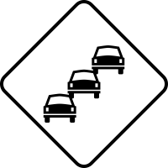
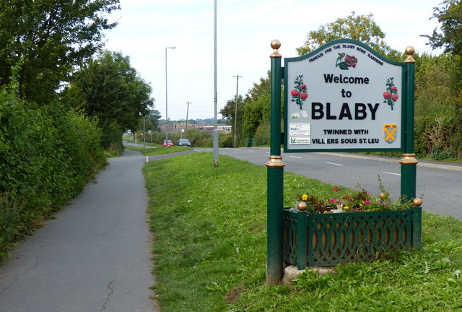
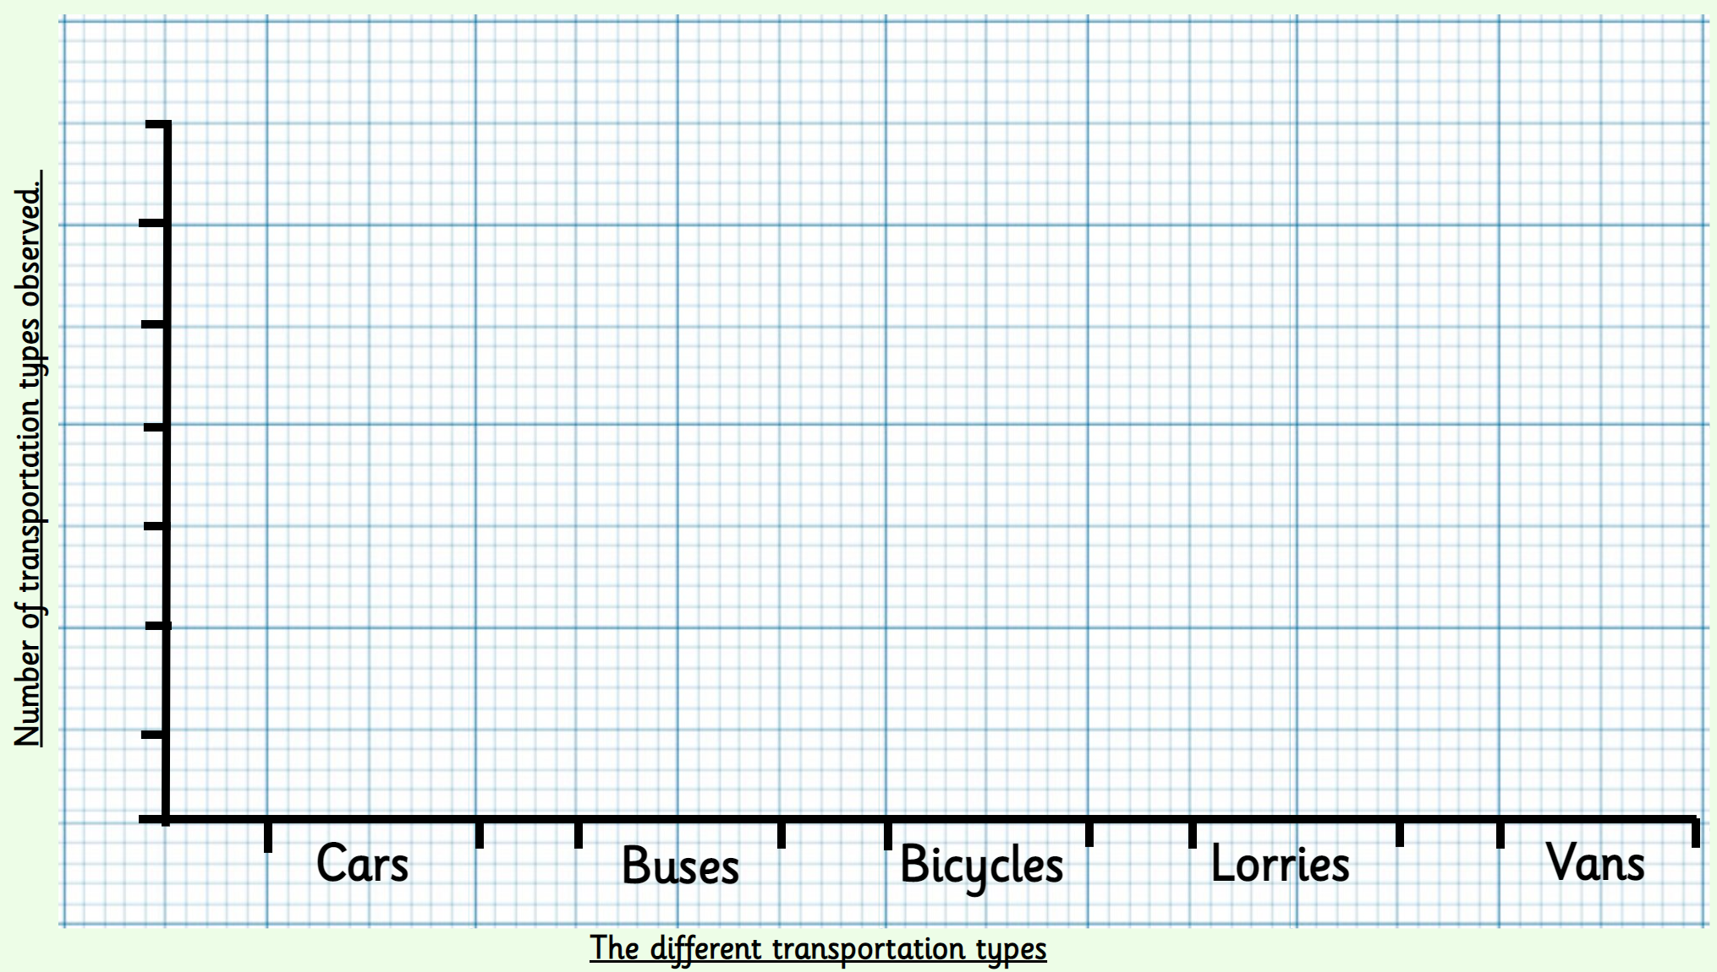

| Year 5 Knowledge Organiser – Unit 2 Geography |
How has our area changed over the last century?
KQ1 How has our area changed over the last century?
Leicester has been a city since Roman times. Leicester has many links to different industries. The population of Leicester was in 2001 and to know what it has increased to in 2019 There used to be a tomato farm on the grounds of Blaby Stokes. Many different communities and nationalities have moved to Leicester over the past centuries. The number of cars on Leicester/Blabys’s roads as increased significantly over the past two decades as a result of the population increase. The changes to Blaby and Leicester are mirrored by changes to the UK.
KQ2: What is the traffic like near our school?
Field Work
3. How has car ownership changed over the decades?
The number of households without a car has dropped over the last few decades. People now travel further to jobs. This has caused problems, like pollution and traffic congestion.

