Slide 1
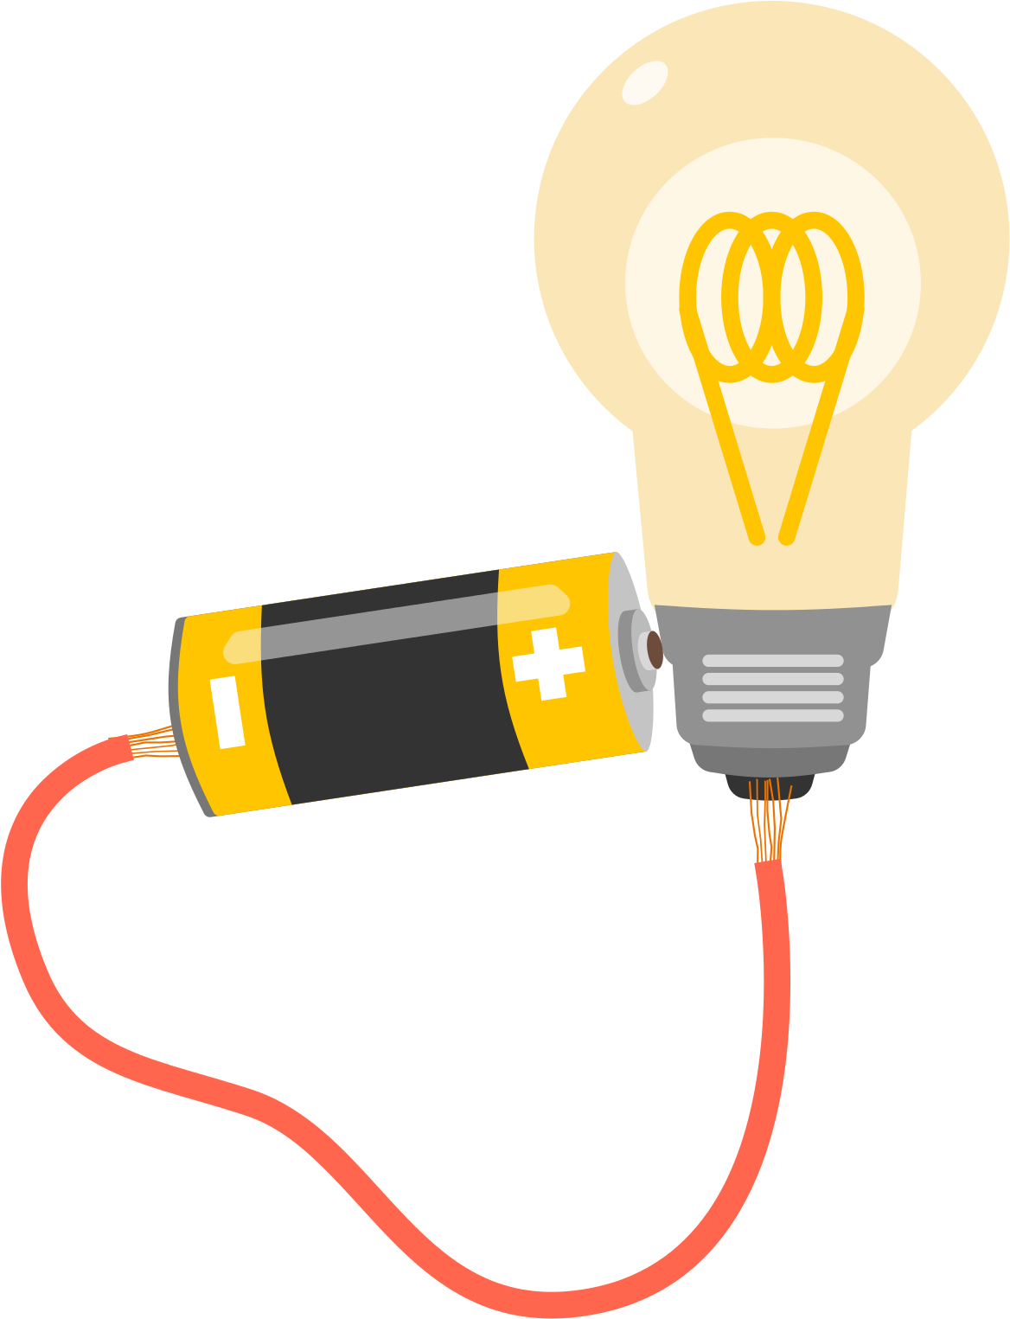

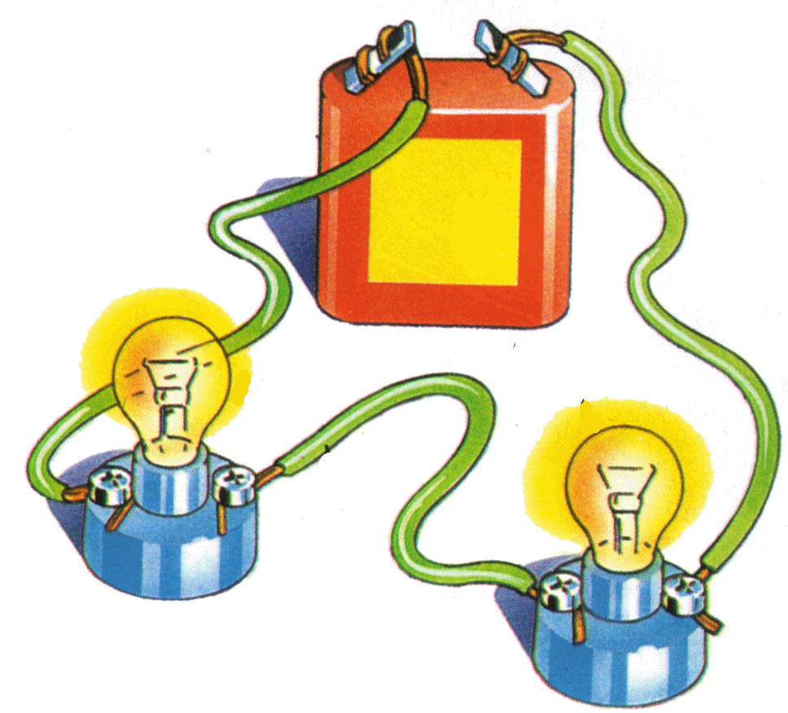
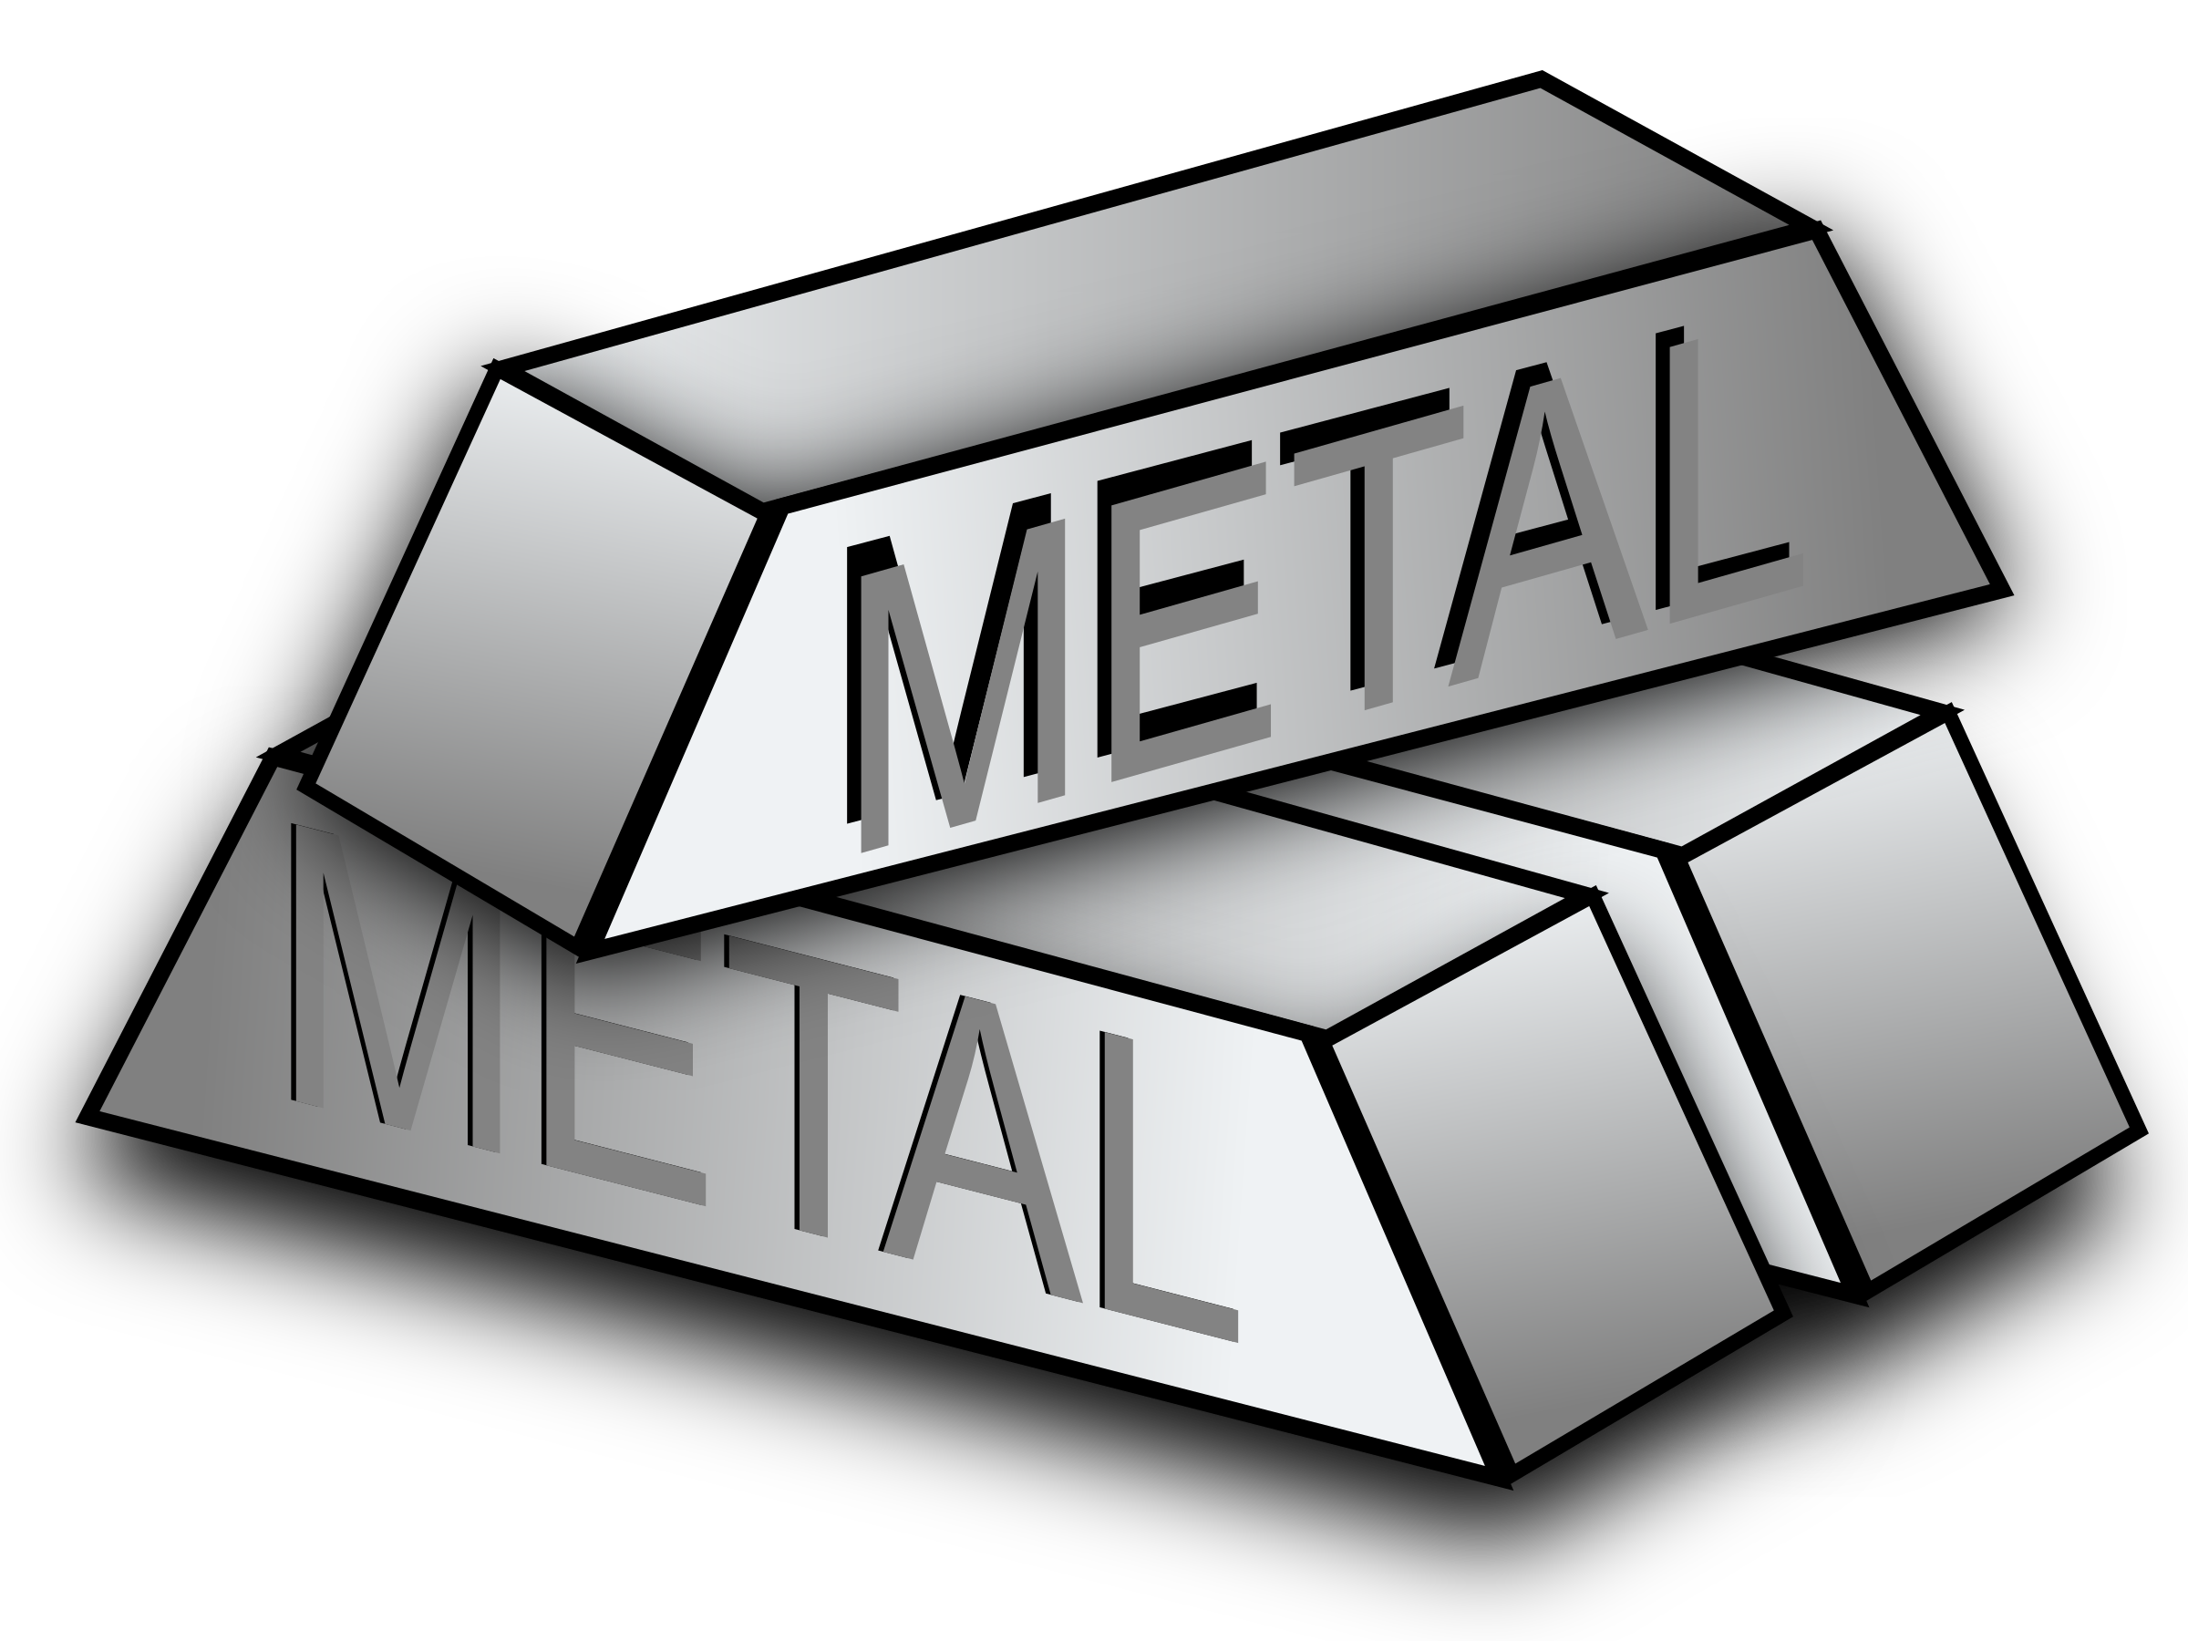
| Year 4 Knowledge Organiser – Unit 3 Science |
Electricity.
KQ1: What do I already know about energy and materials?
Science is a way to understand our world by carefully thinking about it and testing our guesses with observations and experiments. An object is made from/of a material. Metal is a material from which objects can be made. Matter (stuff) is made from tiny building blocks. Energy comes in different forms and can be neither created nor destroyed, only changed from one form to another.
KQ2: What is electricity?
Electrical energy is one of many forms of energy. Static electricity is an imbalance of charged particles on a material; it does not operate by flowing around a complete circuit. Current electricity is the flow of charged particles called electrons around a circuit. Current electricity is the form of electricity that we use in our lives in lights, computers, televisions, etc. Cells, batteries and the mains are all sources of electrical energy .
KQ3: What is an electrical conductor?
Electrical current flows well through some materials, called electrical conductors, and poorly through other materials, called electrical insulators. Conductors have free electrons (tiny, negatively charged particles) and when electrical current flows around a conductor the electrons move. Electrical conductivity (how well a material conducts electricity) is an example of a property. Metals are good electrical conductors.
KQ4: What do I need to create an electrical circuit?
Electrical current can flow if there is a complete circuit. Wires – which contain a conductor inside them, usually made of metal – can allow electrical current to flow around a circuit When electrical current flows through a circuit components within that circuit – such as buzzers which make a noise and bulbs which emit light – begin to work. Switch functions by completing or breaking a complete circuit. Exposure to high levels of electrical current can be dangerous.
KQ5: Who was Michael Faraday and what did his work teach us about electricity?
Michael Faraday was a scientist who studied electricity. He invented the electric motor and showed that the movement of a magnet could create electricity, which is the reason we can generate electricity to power our world. He is considered “the father of electricity”

