Slide 1

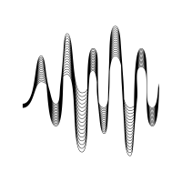

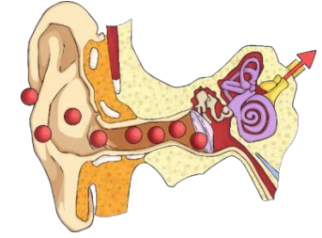

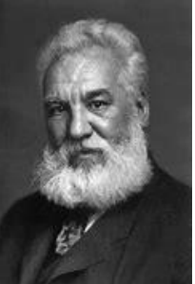

| Year 4 Knowledge Organiser – Unit 2 Science |
Sound
KQ1: How is sound made?
Energy comes in different forms and can be neither created nor destroyed, only changed from one form to another. Sound is generated when an object vibrates; some of the energy from the vibrating object is transferred to the air, making the air particles move.
KQ2: How does sound travel?
Sound is a form of energy that transfers in a longitudinal wave. Sound can travel in two ways: through air to your ears ( this is how TV speakers work) or through an object/ material like stone, brick, water and glass. When a guitar string is plucked or a drum skin is hit, you can see the material vibrate. Sound travels through a medium (e.g., particles in the air) and thus sounds do not travel through a vacuum which has no particles in it at all.
KQ3: How do I hear sounds?
We hear sound from the ear. The outer ear – the part that we can see on the side of our heads The middle ear – contains the hammer, anvil and stirrup – the middle part of the ear (the three smallest bones in the body). The inner ear – contains the cochlea, which turns the vibrations into electrical signals. That the outer ear funnels the sound into our heads through the ear canal. That the air vibrates and hits our ear drums and makes them vibrate. That the vibration is then sent as signals through the auditory nerve to our brain and then we can hear it as a sound we recognise.
KQ4: What happens when the volume of a sound gets louder or quieter?
Volume is how loud or quiet a sound is and that this is determined by the amount of energy in the wave (e.g., from how hard or soft a percussion instrument is hit). The volume of a sound is quieter if the listener is further away from the object.
KQ5: What happens when the pitch of a sound gets higher or lower?
Pitch is how high or low a sound is and that this is determined by how many vibrations per second are being made by vibrating object; the number of vibrations per second is called frequency. The shorter the vibrating object, the hight the sound. The longer the vibrating object, the lower the pitch of the sound.
KQ6: How did Alexander Graham Bell help everyone share sounds across distances?
Alexander Graham Bell is famous for inventing the telephone. He experimented with transmitting speech: sending sound from one place to another.

