Slide 1











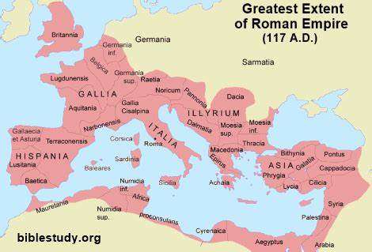
| Year 4 Knowledge Organiser – Unit 3 History |
Romans: Why did the Romans come to Britain and how do we know they were here?
HISTORICAL CONTEXT
KQ1:Who were the Romans?
Augustus was the first emperor of ancient Rome. An emperor or empress is a monarch who governs many nations or separate territories; a group of nations or separate territories ruled by an emperor or empress is called an empire. The Roman Empire also controlled the territory that is now called Palestine, where Jesus Christ was born; in the nativity story of the Bible. The Roman Empire in this part of the world continued to be led by emperors, who were effectively dictators, for around five centuries. The Roman Empire was enlarged by its powerful and well organised military; men from all over the empire joined the Roman army with a promise of money or land if they served in the army for 25 years; there were people of a variety of ethnicities within the Roman army.
KQ2: When and why did they invade Britain?
The e first Roman invasion of Britain in was 55 BCE. Many people within clans and tribes would have been involved in farming in some way, though some would have been involved in specialised roles like making weapons or other craftwork. Julius Caesar’s army invaded in 55 BCE and 54 BCE, but he did not conquer the territory. Britain was conquered around a century later by the Roman army in 43 CE on the orders of Claudius, the Roman Emperor at the time. The reason for conquering Britain was partly for the metals that could be mined in Britain and used across the Empire; it was also considered an achievement to conquer Britain precisely because of how far away it was from Rome. The Roman generals - as they often did as part of conquering a new territory - made treaties with leaders to make it easier to govern the parts of Britain that they had conquered.
KQ3: How did the Romans design and build roads and why were they important? Are they still important to us today?
Romans changed the way of life in much of what we now called Britain; they built large towns with stone houses containing heating; they also built sewage systems and long, straight roads connecting these towns, evidence of which can still be found today (e.g. Fosse Way and Watling Street); the Romans also built temples to their gods across Britain. The Romans, there were no proper roads in Britain and the Celts used paths and tracks. Roman roads meant that: Troops could be quickly moved from one place to another. There were better links between places for trading. The Emperor had more control if messages could be sent quickly. Supplies could be sent to different parts of the country. Romans built long straight roads. Roman roads linked military centres to ports. There is evidence today of Roman roads in Britain. Camber is where the middle part of the road is higher than the sides to allow for drainage.
Celts
800BC
Romans
AD 43
Saxons
AD 450
Vikings
AD 793
Normans
1066
Tudors
1485
Victorians
1837
KQ4: What was the legacy of the Roman invasion in Britain?
Language and the calendar (Latin roots, names of places even Britain from Brittania) Roman Numerals Law and Order Contracts Trial by jury Census Christianity and monotheism Plants and foods Building (aqueducts, viaducts, sewers, churches).
WWII
1939
KQ5: How do we know there were Romans near Blaby?
The Romans lived near Blaby. Leicester was an important Roman town. Roman artefacts were found during excavations in Bouskell Park.

