Slide 1
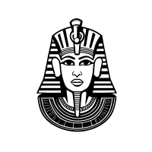
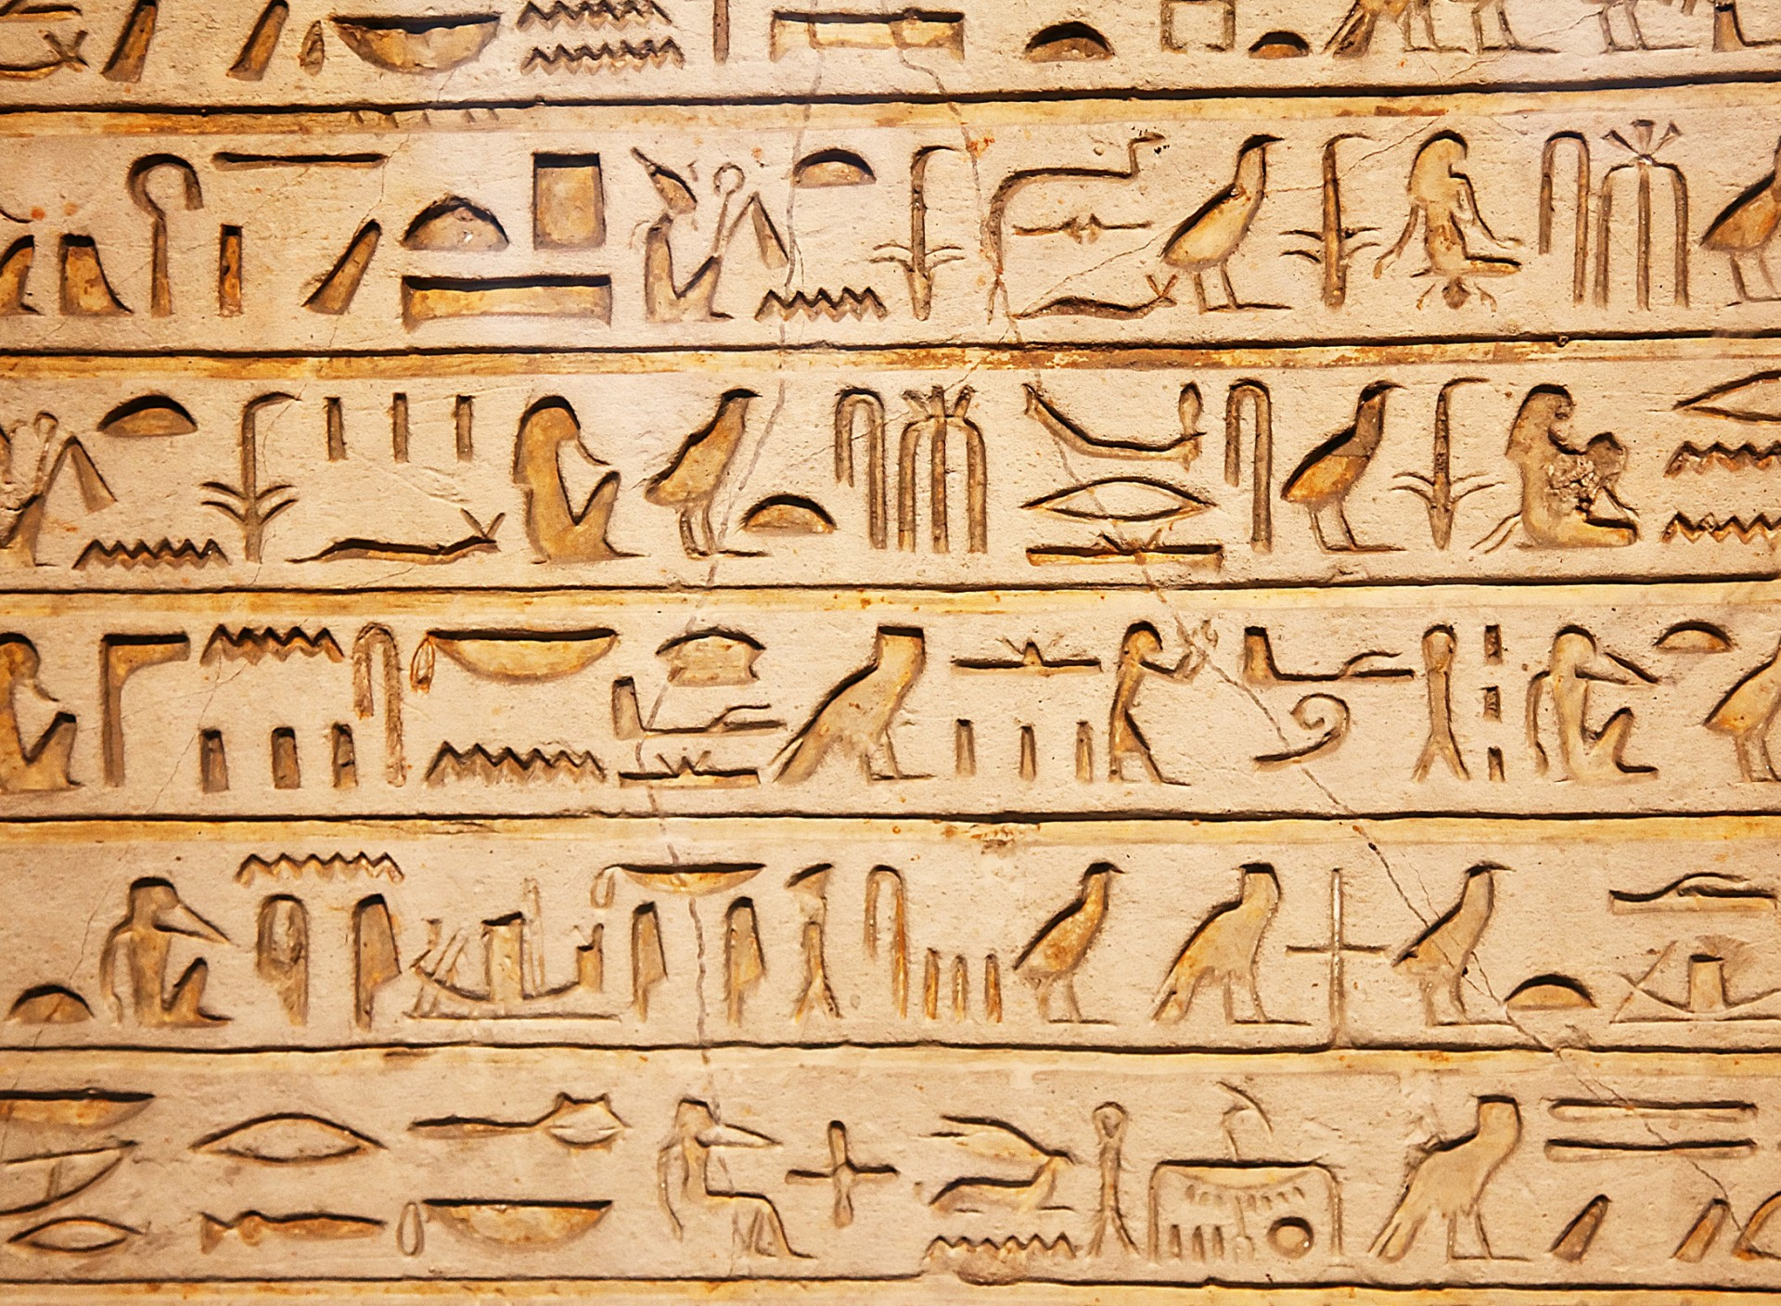

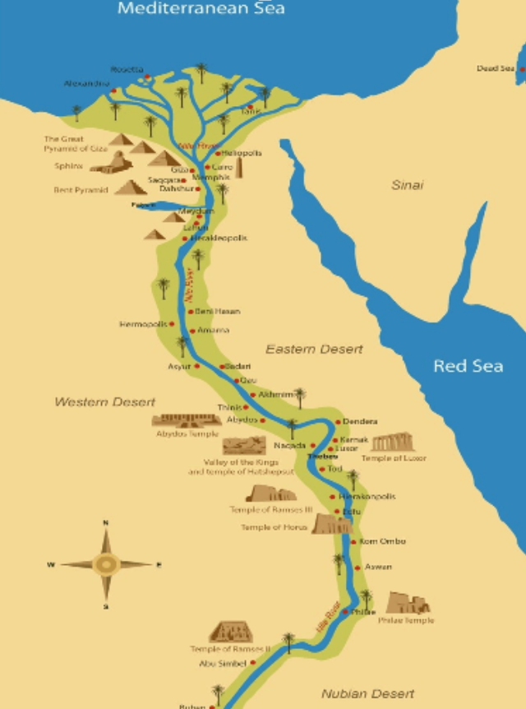



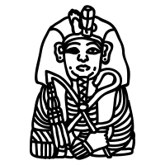

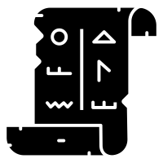

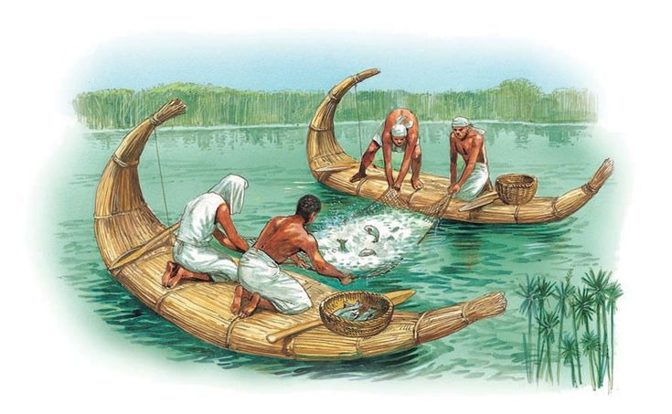

| Year 3 Knowledge Organiser – Unit 2 History |
Why was the River Nile so important to the ancient Egyptians?
KQ1: When was the Ancient Egyptian period and how does that fit in with other periods in history?
The Ancient Egyptian period at the same time as the Bronze and Iron age. The Egyptian Kingdom was mostly before the Roman Kingdom.
KQ2: What were key features of the Ancient Egyptian Kingdom?
Ancient Egyptians used a system of writing based on pictograms called hieroglyphs. Leaders were called Pharaohs. The Egyptians were either rich and powerful or slaves Some of the stories in the Bible occurred in Egypt, particularly the stories of Moses.
KQ3: How did the Ancient Egyptians use the Nile to help them grow crops?
The River Nile was important for growing food. When plants were growing the land needed to be irrigated form the Nile. A shaduf was used to help irrigate the land. A range of crops were grown along the Nile.
HISTORICAL CONTEXT
Stone Age
2.4 million – 3000 BC
Bronze Age
3000 – 700 BC
KQ4: How did the Ancient Egyptians use the Nile to help them live?
Fish were caught from the Nile. Bricks were made for houses using the mud from the Nile. The Ancient Egyptian calendar was based on the annual inundation and fall of the Nile. The Nile provided protection for the Egyptians. Papyrus which grew along the Nile was used for making e.g. paper, rope, mats, sandals.
Ancient Egypt
3000 – 30 BC
Shang Dynasty
1760 – 1000 BC
Ancient Greece
1200 – 146 BC
KQ5: How was the Nile important for trade in Ancient Egyptian times?
The Nile was used for transport. The Nile was used for the trade of goods grown.
Iron Age
825 BC – 43 AD

