Slide 1
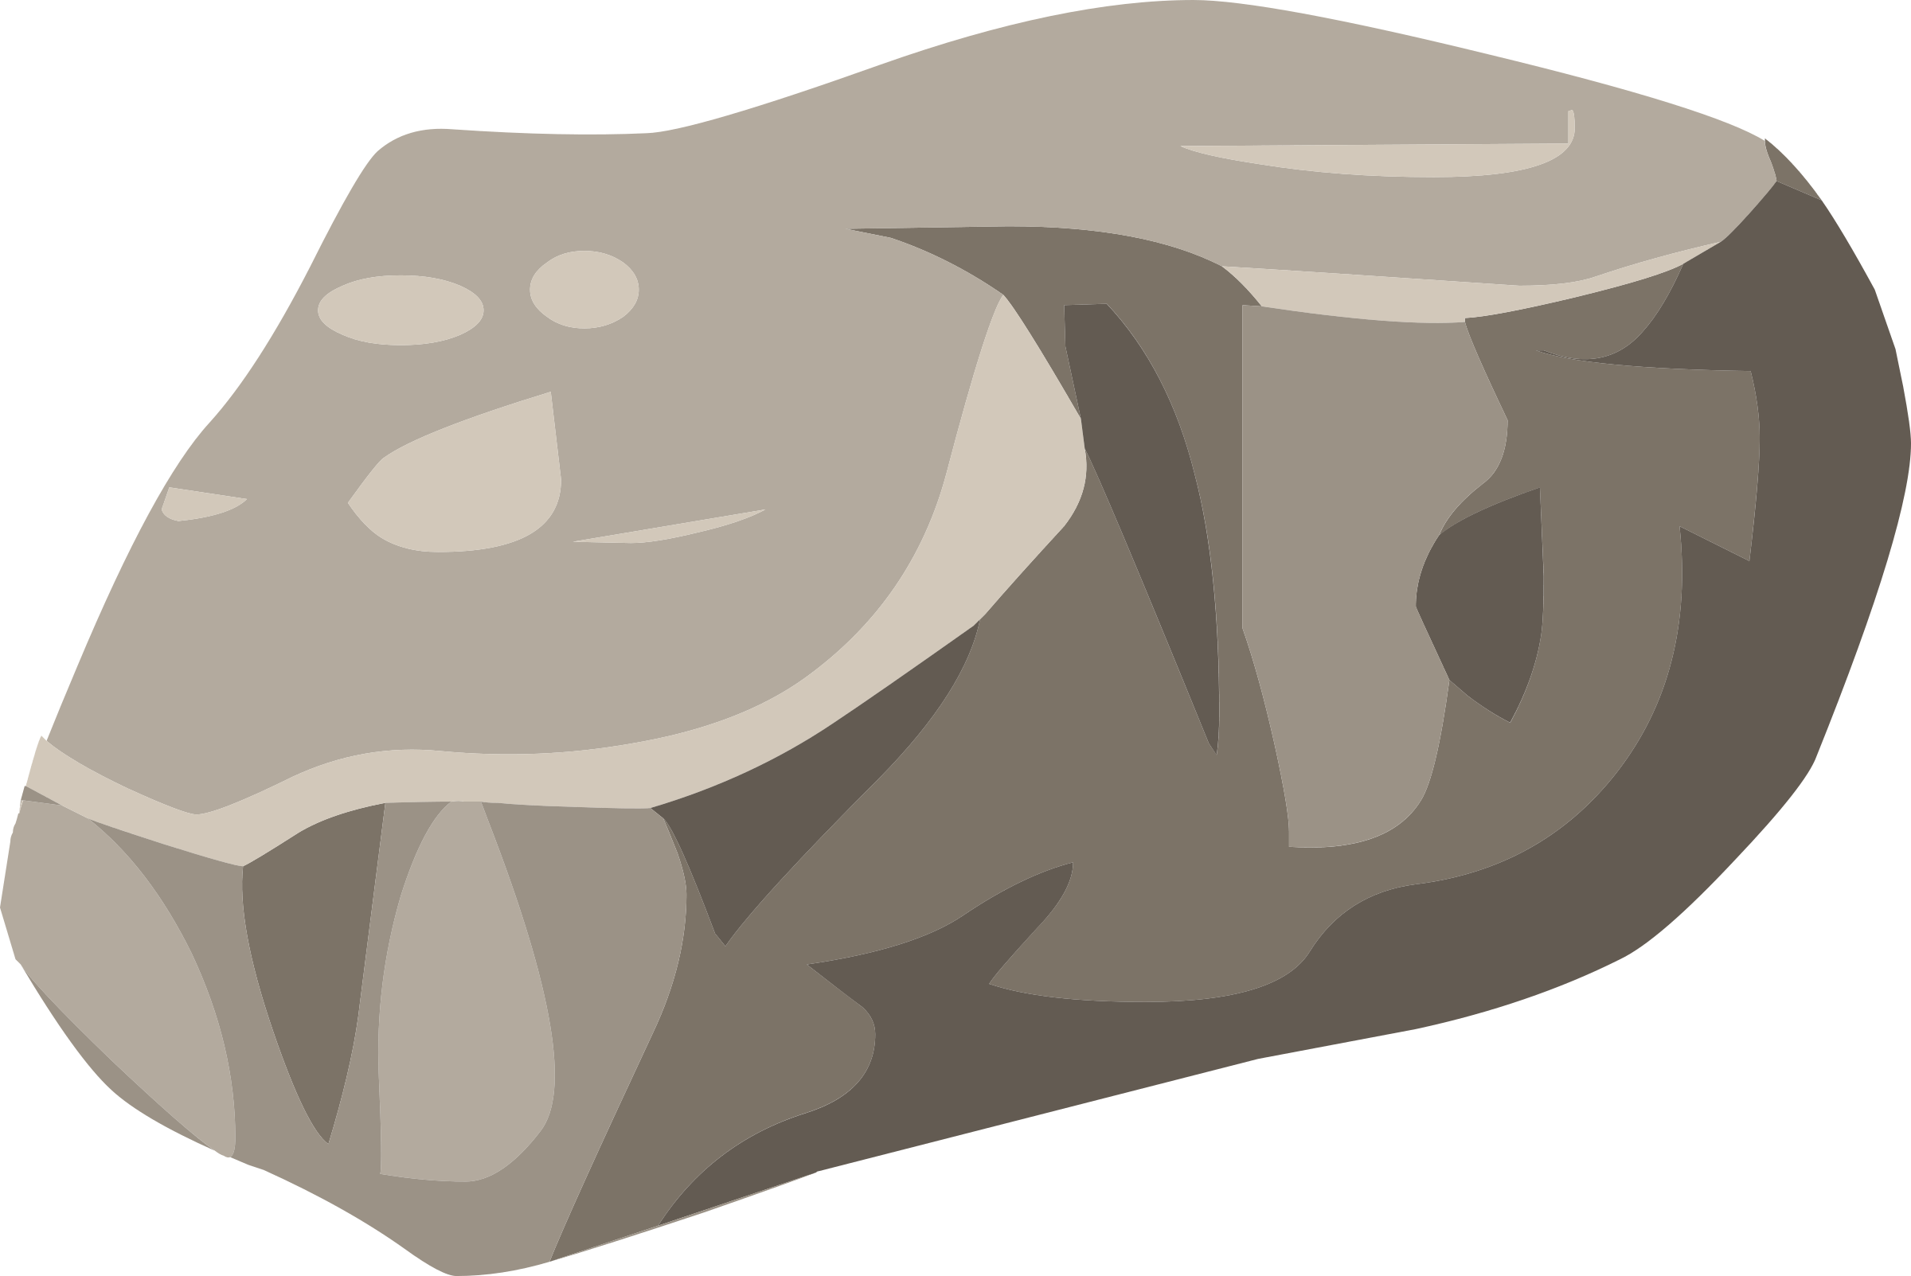


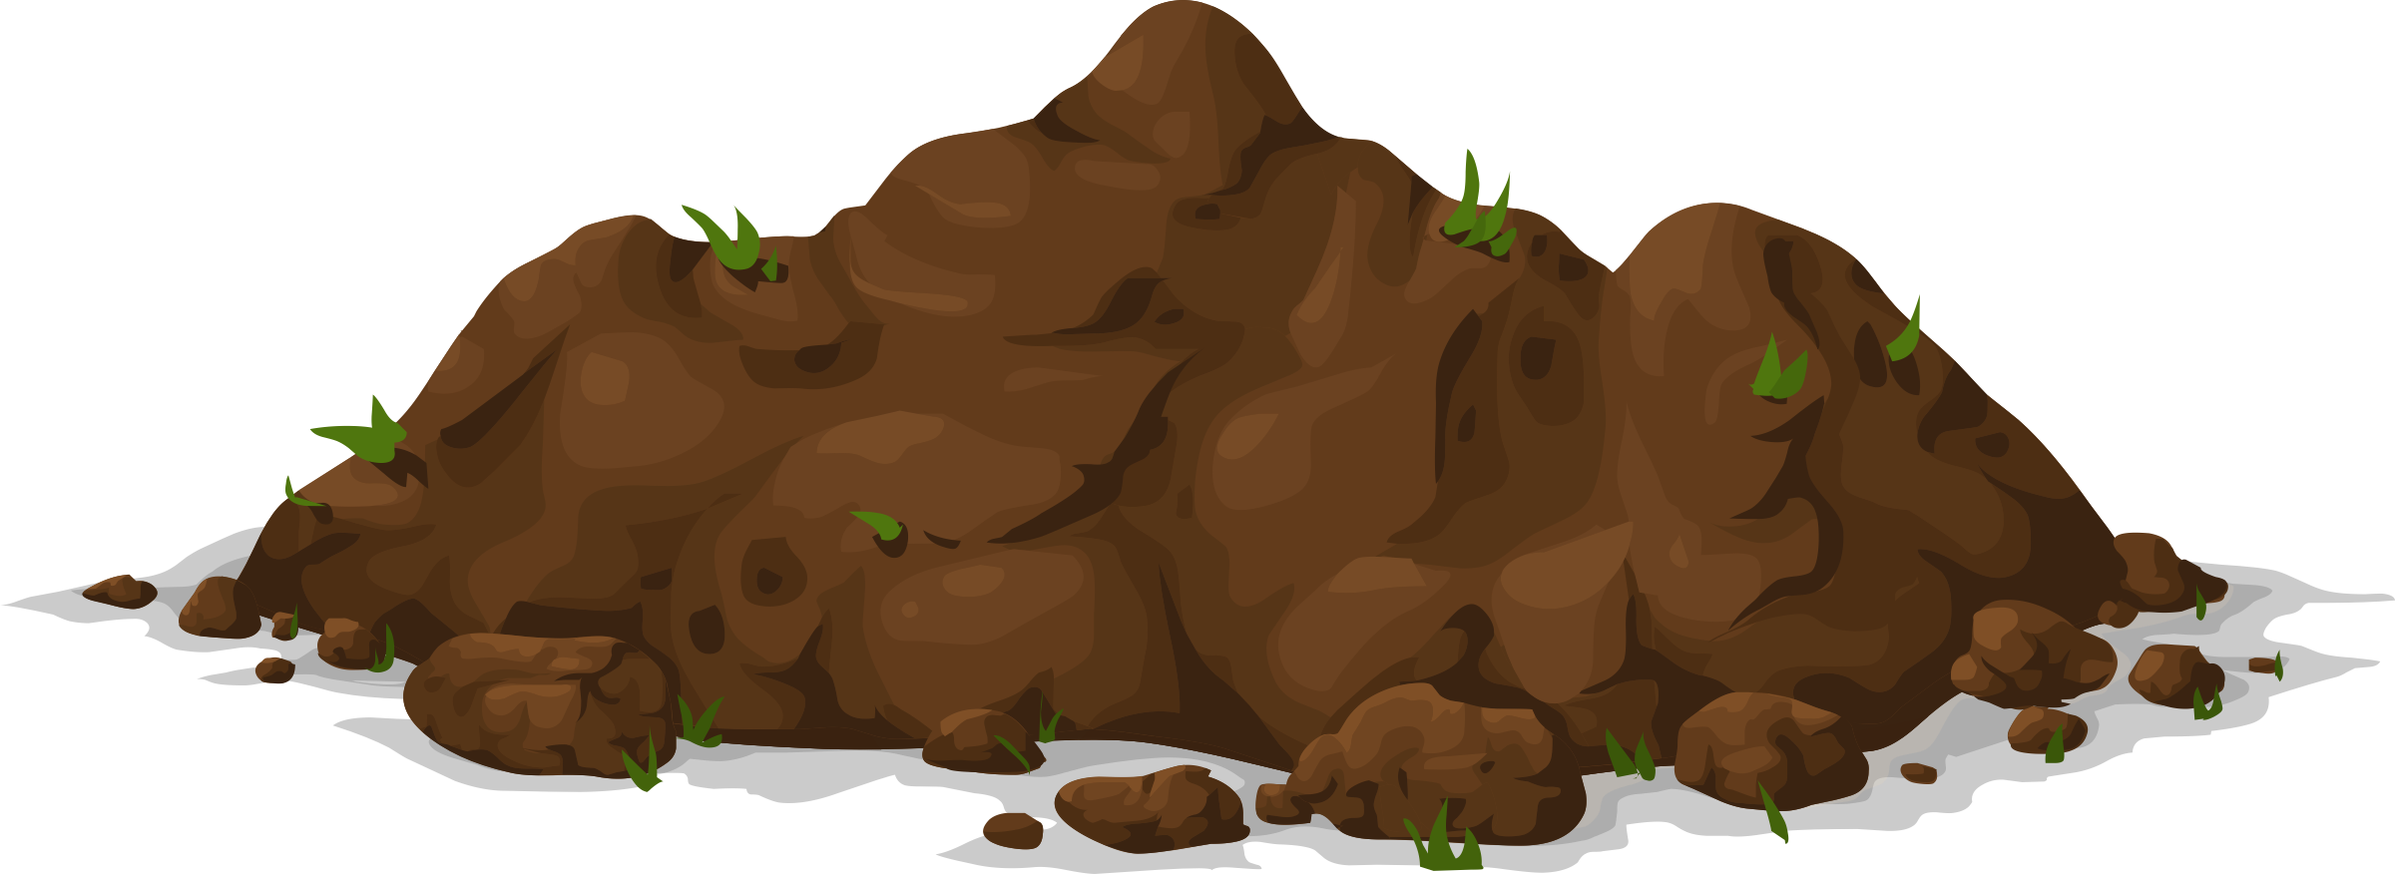
| Year 3 Knowledge Organiser – Unit 3 Science |
Rocks and soils.
KQ1:What are rocks and how do they form?
Rock is a naturally occurring material. There are three basic types of rock: igneous, sedimentary, and metamorphic. Igneous rock is made by lava cooling and solidifying and crystalizing (e.g., basalt, granite). Sedimentary rock is made by broken sediments of other rocks (air, water, ice, wind) and it falls into water where they join through sedimentation (e.g., sandstone, coal, chalk). Metamorphic rock is made by other rocks that change due to heat or pressure (e.g., slate, marble). Different types of rock e.g., sandstone, limestone, slate etc. which have different properties. They have different sizes of grain or crystal. They may absorb water. Rocks can be different shapes and sizes (stones, pebbles, boulders).
KQ2: Why are there fossils in some rocks?
Some rocks contain fossils. Fossils were formed millions of years ago. Fossils are formed by special circumstances. When an animal dies, the soft parts of the body decompose leaving the skeleton behind. This becomes buried under sediment. Layers of sediment built up on top of the skeleton and these compact and turn to rock. The bones are then dissolved by water that seeps through the rock. Minerals in the water replace the bone, leave a rock in the shape of the skeleton, leaving behind a skeleton.
KQ4: How did Mary Anning help us to understand about rocks and soils?
Mary Anning was born on 21 May 1799. She lived in the English seaside town of Lyme Regis in Dorset. Mary would spend her time searching the coast looking for what she called ‘curiosities’. Later in her life, as she developed a better understanding of her finds, she realised they were actually fossils. Over the course of her life, she made many incredible discoveries. This made her famous among some of the most important scientists of the day. They would visit her for advice and to discuss scientific ideas about fossils. Today, Mary is remembered as one of the greatest fossil hunters to have ever lived.
KQ3: How are soils produced?
Soils are made up of pieces of ground down rock which may be mixed with plant and animal material (organic matter). The type of rock, size of rock pieces and the amount of organic matter affect the property of the soil. Soil is made up of rocks, water, air, and organic matter. Organic matter provides plants with food when they are in soil.

