Slide 1


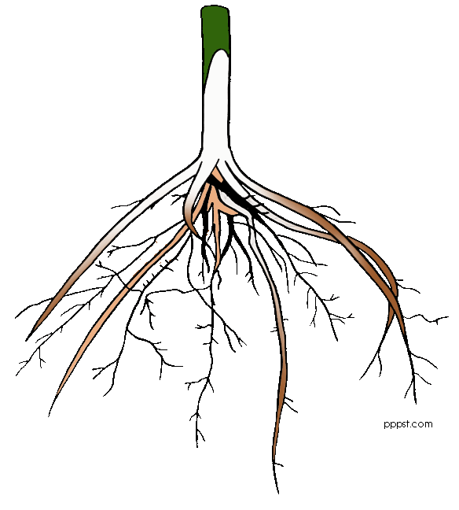



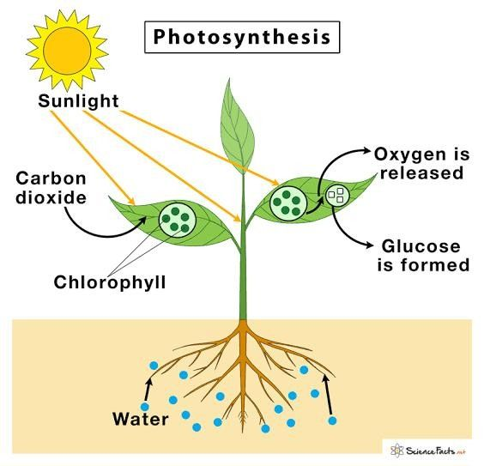

| Year 3 Knowledge Organiser – Unit 2 Science |
Plants
KQ1: What do plants need to grow well?
Plants need air, light, water, nutrients from the soil and room to grow. The life and growth of a plant varies from plant to plant. Plants will grow differently when they are put in different conditions e.g., in darkness, in the cold, deprived of air, different types of soils and different fertilisers. Many plants, but not all, have roots, stems/trunks. Leaves and flowers/blossom. These different parts of plants have one or more functions (jobs).
KQ2: Why do plants have roots?
Roots collect water and minerals from the soil. Roots holds the plant firmly in the ground.
KQ3: Why do plants have stems?
The stem holds up the leaves so that they can gather light to make food and it also holds up the flowers so that they can receive pollen and disperse their fruits. The stem also transports water and minerals from the roots to the other parts of the plant.
KQ4: Why do plants have leaves?
The leaves make food by absorbing light and using its energy to turn carbon dioxide and water into carbohydrates. This process is called photosynthesis.
KQ5: Why do plants have flowers?
The function of a flower is reproduction, where flowers of the same kind exchange pollen – made by an anther – in a process called fertilisation, and a structure in the flower’s ovary called an ovule becomes a seed; the ovary then becomes a fruit which helps the seed leave the plant in a process called dispersal.
KQ6: Why do plants have seeds?
Plants take advantage of many habitat opportunities by dispersing their seeds. Not all plants produce seeds, but those that do, use them to replicate themselves.

