Slide 1
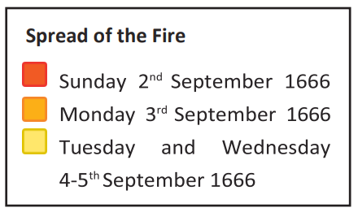
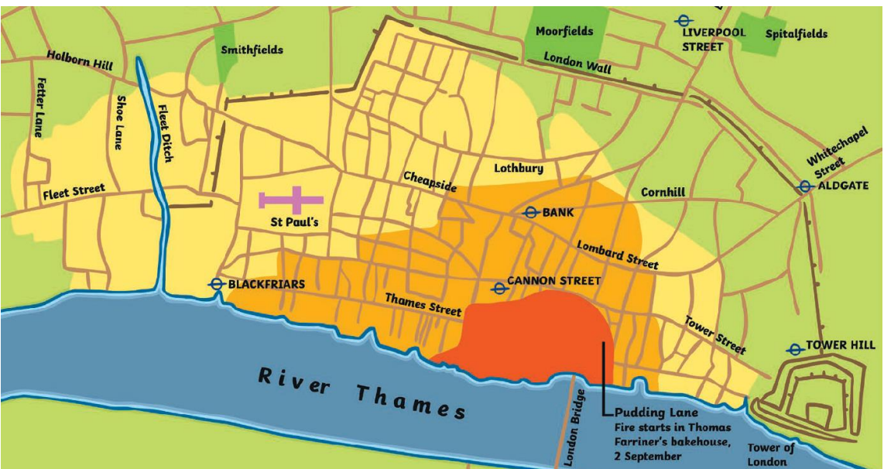




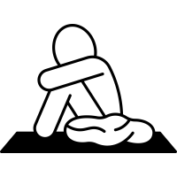
| Year 2 Knowledge Organiser – Unit 2 History |
What was the Great Fire of London, and what consequences did it have?
KQ1: What was it like to live in London 450 years ago?
In London there were buildings like it crammed together, with roofs made of straw. Some of the buildings in London are the same now as in 1600 but many have changed because there was a big fire in 1666.
KQ3: How did the fire spread and how did people stop it?
It was spread by the wind to cover most of London North of the river. People could not put out the fire because it was too fierce and the buildings in London caught fire easily. The fire burned out when the wind pushed it towards the river.
KQ4: How do we know about the Great Fire of London?
Samuel Pepys kept a diary about the Great Fire of London which we can still read today.
KQ5: How did the Great Fire of London change the way people built?
After the fire, housing changes to make buildings relatively safer Sir Christopher Wren redesigned London and some of his buildings still stand today.
KQ6: How did the Great Fire of London change the way people fight fires?
Fire fighting has changed from the1600s to today.
KQ2: What are the significant dates and events of the Great Fire of London?
The Great Fire of London started in a bakery shop in pudding lane one morning.
Sunday 2nd Sept 1666
Monday 3rd Sept 1666
Tuesday 4th Sept 1666
Wednesday 5th Sept 1666
Thursday 6th Sept 1666
The fire starts at 1a.m.
Mid-morning – Samuel Pepys starts to write about the fire in his diary.
The wind dies down the fire and it spreads more slowly.
The fire is put out.
Thousands of people are left homeless.
The fire gets very close to the Tower of London.
St Paul’s cathedral gets destroyed by the fire.

