Slide 1
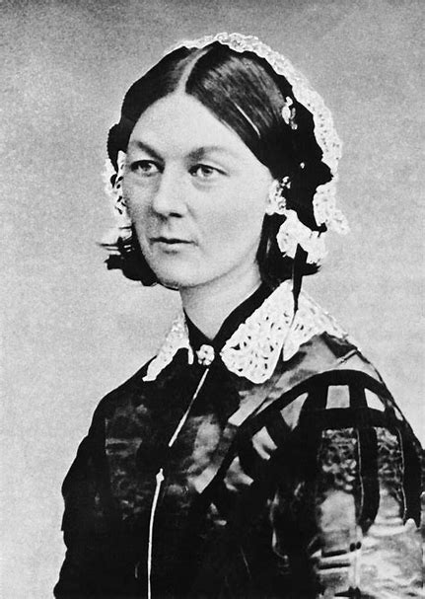






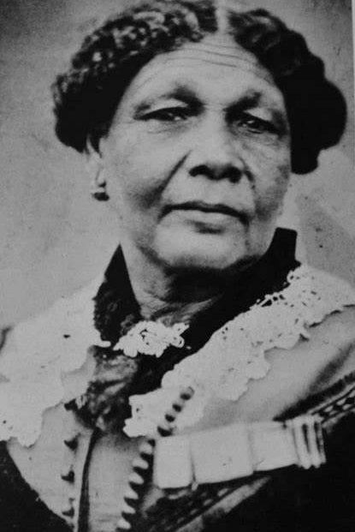


| Year 2 Knowledge Organiser – Unit 3 History |
Nursing – What is nursing, and what famous nurses have lived in Britain?
KQ1: Why is Florence Nightingale remembered today and what did she do in her life?
Florence was born in 1820 in a big city in Italy. It's called Florence and that's how she got her name. She went to the Crimean War to nurse wounded soldiers. She became known as ‘The Lady with the Lamp’. Florence Nightingale is remembered for showing people that nursing was a very important job.
KQ3: What did Florence do to help the soldiers and did everyone have the same opinion of her?
In the military hospital thousands of injured soldiers died of diseases and infections. This was because of the filthy conditions. Nightingale said people should wash their hands in hospitals. This helped bring the number of deaths down from 41% to 2%.
KQ5: Why have we learnt so much about Florence and so little about Mary Seacole?
Mary Seacole lived an exciting life, travelling to many different countries and nursing wounded soldiers. Mary Seacole wanted to travel to the Crimean War to help British troops, but the Government refused. Mary funded her travel to Crimea herself and built a hotel there. We learn more about Florence because much of what we know about clean, organised hospital conditions today is thanks to Florence’s hard work and research.
1820 –
Born in Florence
1837 - Florence felt God call to her to serve Him.
Oct 1853 –
Crimean War began
1854 – Florence went to Turkey to care for soldiers and saved many lives.
March 1856 –
Crimean War ended
1860 – Nightingale training school opened
KQ2: Why did Florence go to the Crimea and who influenced her?
Florence went to Crimea and took nurses with her. To stop disease, she cleaned the hospitals and gave patients healthy food. In 1853 Florence Nightingale was the head of a nursing group in London. The next year she went with 38 trained nurses to the war in the Crimea. Britain was fighting there against Russia.
KQ4: What were the most important achievements of Florence’s life?
In 1860 she set up a training school at St. Thomas’s Hospital in London. The hospital still exists today. She wrote a famous book, Notes on Nursing which was used to train nurses. Her trained nurses went on to work in hospitals around Britain and the world.
KQ6: How should we remember Florence Nightingale and Mary Seacole?
Both were great nurses who worked at the same time. Florence Nightingale –1820-1910 A nurse best known for founding modern nursing & treating soldiers in the Crimean War Mary Seacole –1805-1881 A nurse and business woman, best known for her work in helping the sick and wounded – particularly during the Crimean War.
1805 –
Born in Jamaica
Mary’s mother was a nurse. At 12, Mary started to help her mother care for the sick.
1854 – Mary travels to London to help care for Crimean war soldiers. She gets turned down. Travels to Crimea anyway.
Mary opens the British hotel which sold supplies to British soldiers and ran a clinic for ill soldiers.

