Slide 1
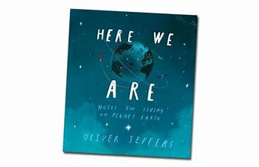
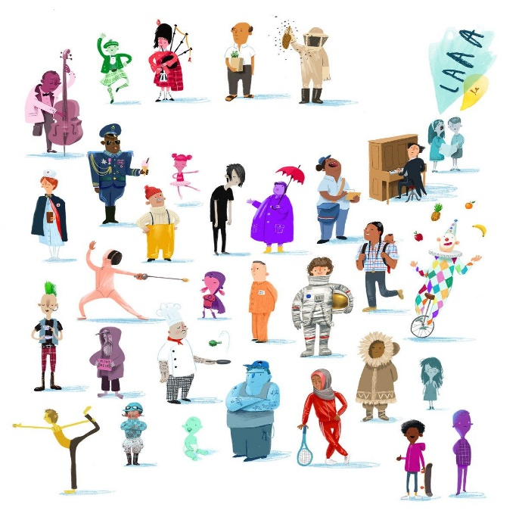
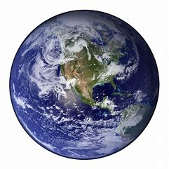
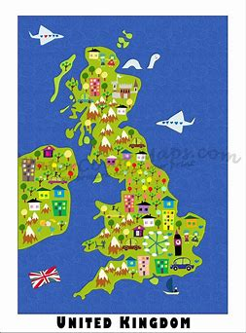
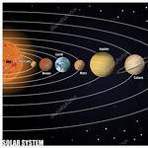
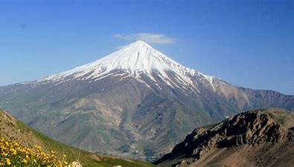
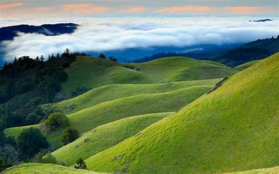
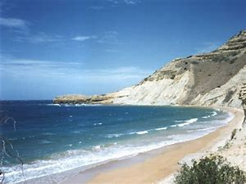
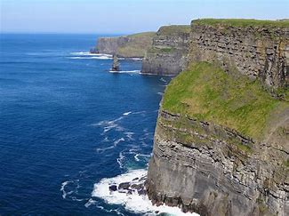
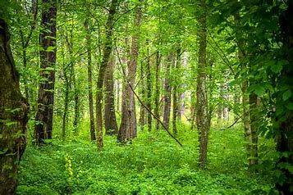
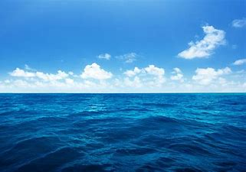
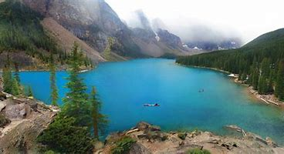
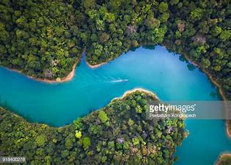
My Place in the World
Autumn 2
Knowledge organiser
Please talk to your child about our topic and share stories about your own family, your roles, your home and your culture. You can help by pointing out geographical features.
Earth is made up of land and sea.
Our key text this term is ‘Here we are’ by Oliver Jeffers.
Key vocabulary:
Space, solar system, planet, star, moon, sun, day, night, shadow, Earth, globe, weather, seasons.
Children will know that there is life on Earth in the form of humans and animals.
They will understand that humans can look, act and sound very different. Despite these differences we are all human beings.
Children will begin to understand that people hold different roles within their local communities.
They will look at the lives of families throughout the world and find similarities and differences.
Children will consider how times have changed and think about how their lives differ from that of their grandparents and great grandparents.
Children will look at a variety of maps (paper and electronic) and find out about key codes. They will understand the term ‘bird’s eye view’.
Mountain Hills, valleys Coastline, beach Cliffs Forests,woodland Ocean, sea Lake River

