Slide 1
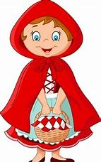
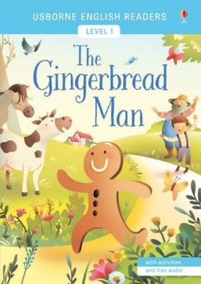
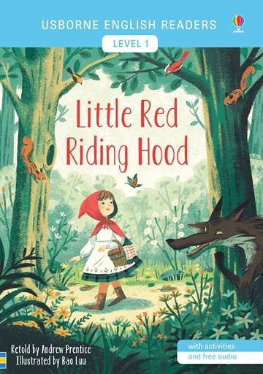
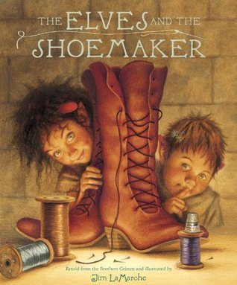
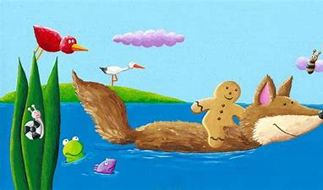
UNIT 3: FS KNOWLEDGE ORGANISER – Can you tell me a story? (Traditional Tales & materials)
English key texts: traditional tales
Science investigations: materials
Which material would make the
best waterproof cape for me?
If the gingerbread
man fell into the water,
would he float or sink?
Definitions
Traditional tale | A tale that has been retold over many years.
Character | A person or an animal in a story.
Hero/Heroine | The main character in a story. Is usually good and well liked.
Villain | The opposite character to a hero. The villain could be mean, nasty or evil.
Setting | Where the story is taking place.
Fiction | Stories that describe imaginary people and events.
Children will learn:
About different materials, including names
Which materials are suitable for particular purposes
About some of the properties of materials such as if they are waterproof
Children will be able to:
Talk about different materials and explain why they choose to use them for different purposes
Use tools, objects, construction and malleable materials with increasing control
Vocabulary
wood | plastic | hard | rough
bricks | clay | waterproof | smooth
glass | dissolve | strong | soft
metal | absorb | weak | float/sink
fabric | weight | light | manmade
paper | heavy | natural | change
History
Children will learn:
How to be a good listener
New vocabulary
How to act out stories with their peers
How to hold writing tools correctly to form letters
Children will be able to:
Listen with attention, concentration sit quietly during appropriate activities
Follow a story without pictures/props
Use new vocabulary when talking
Role play alongside others, using language to imagine and recreate roles
Use a pencil and hold it correctly to form recognisable letters
Vocabulary
Children will learn:
About what the first shoes were made of
Shoes were an indicator of wealth/status/class
How shoes have changed (manufacture/materials)
Thomas Crick (from Leicester designed machinery to make shoes)
past | handmade
present | manufacture
future | wealth
leather | status
thread | class
machinery

