Slide 1
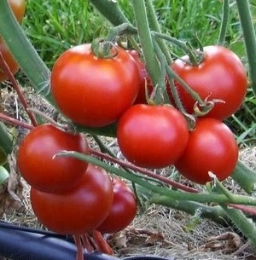
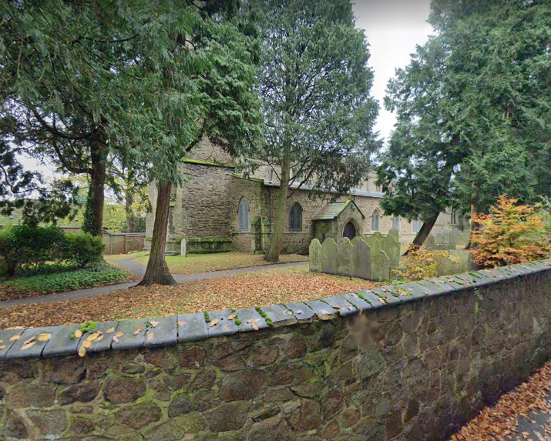
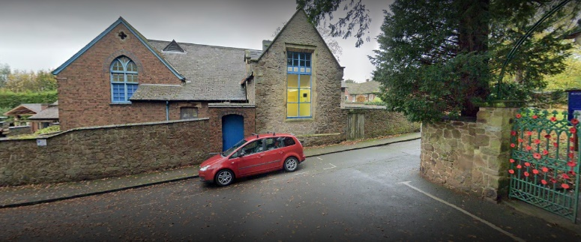
| Year 1 Knowledge Organiser – Unit 2 History |
Me and my school
KQ1: What has changed about my school in living memory?
The school building has changed.
KQ2: Has there always been a school where it is now?
The school was built on the site of a tomato farm which was operated by the Shoults family during the first half of the twentieth century, supplying tomatoes locally and to the war effort in the 1940s. The farm was renowned for its “Blaby Special” tomatoes.
KQ3: Which other buildings in the villages have been used to teach children?
The first school was founded by Rev. Edward Stokes between 1711 and 1724. The CE bit of our name stands for Church of England. We are part of the Church and we visit the church and the vicar comes to do collective worship in school.
KQ4: How has the church been linked with the school over time?
Blaby Stokes is a church school and know some of the historical links the school has with the church

