Slide 1
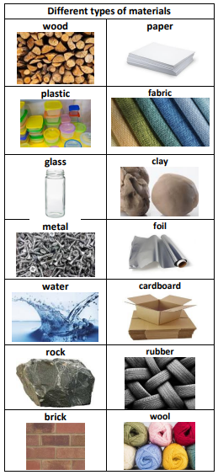
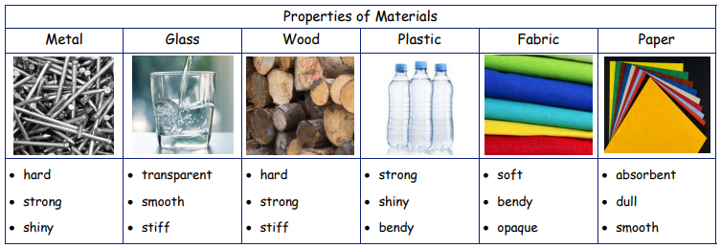

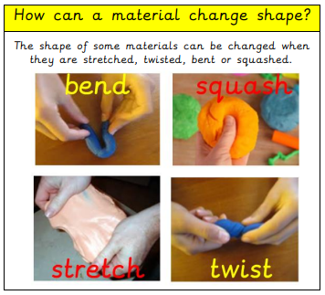
| Year 1 Knowledge Organiser – Unit 3 Science |
Everyday materials.
KQ1: What is a material?
Materials are the substances that things are made from.
KQ2: Are all materials the same?
Different materials have different physical properties which makes them useful for different things. A property is a quality that describes what something is like or how it behaves.
KQ3: How does knowing what things are made from help us to recycle?
Materials of the same type can be collected together and recycled. Recycling isn’t just good for the environment – it’s essential. Recycling is one of the most effective ways to protect and conserve the natural world we live in. By reusing old materials, we save the energy it would have taken to create new ones.

