Slide 1
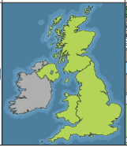
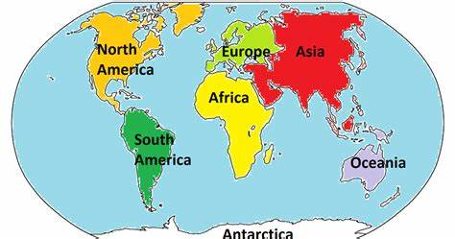
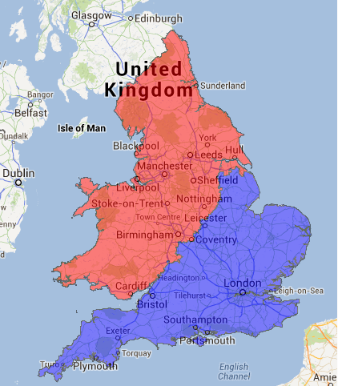
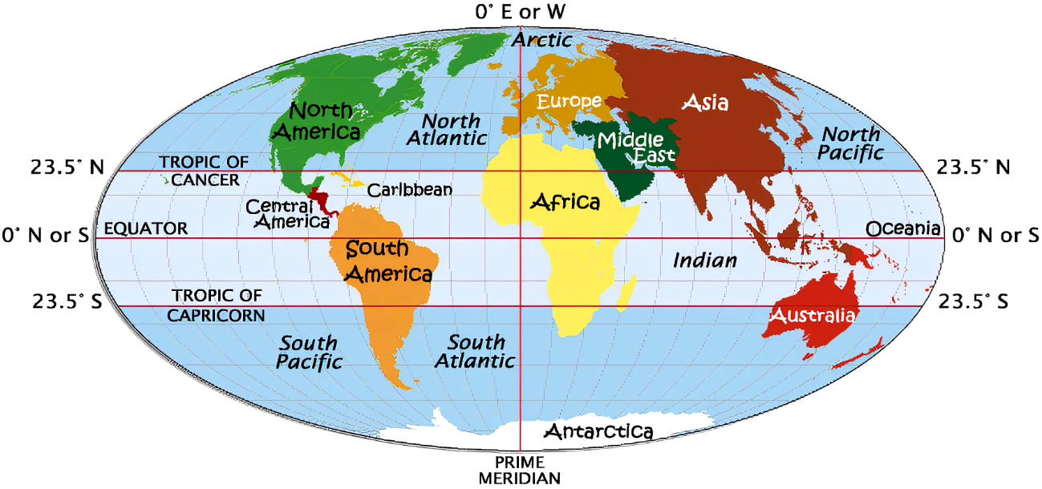
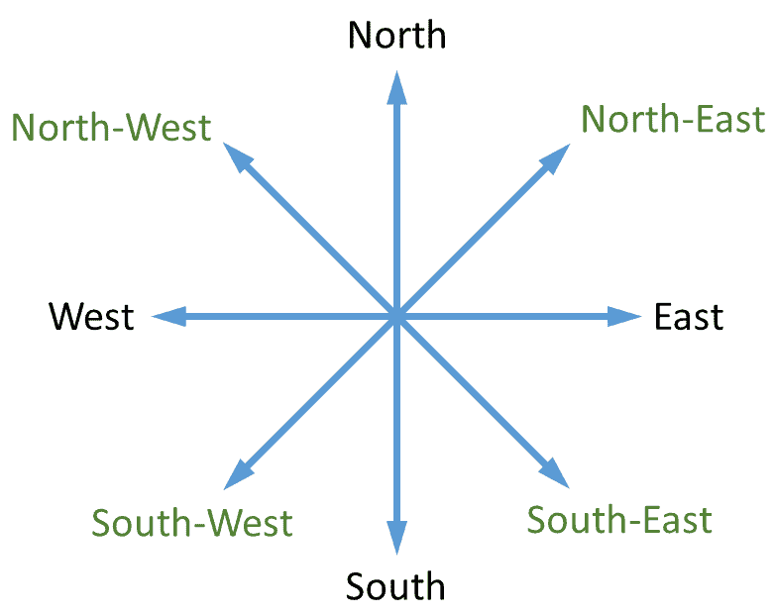
| Year 1 Knowledge Organiser – Unit 3 Geography |
What is our world like?
KQ1 What are the continents and oceans in our world?
The seven continents are: Asia, Africa, North America, South America, Antarctica, Europe and Australia. The five oceans are: Pacific ocean, Atlantic ocean, Indian ocean, Southern ocean and Arctic ocean.
KQ2: Are all the places in the world the same?
.
Key Vocabulary | Definition
map | A drawing of an area shown from above.
Landmark | A landmark is a building or place that is easily noticed
Local area | The area around where you live.
Maps:
A view from above a place
Sometimes have a key with symbols
Show the distance between places
Sometimes have a compass
Can use colour
Symbols show what different things or place can be found in an area.
KQ3: Where are the hot and cold places on the earth? How can I find them on a globe and on a map?
Some places in the earth are nearer to the sun and the effect this has on their climate.
KQ4: How can I accurately describe where one place on a map is compared with another?

