Slide 1


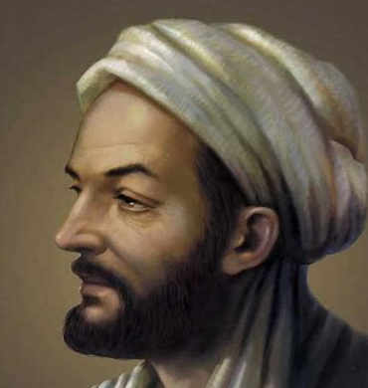
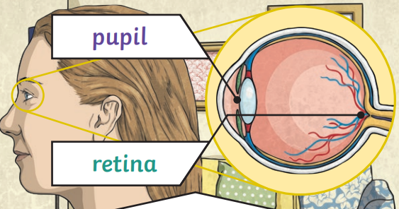
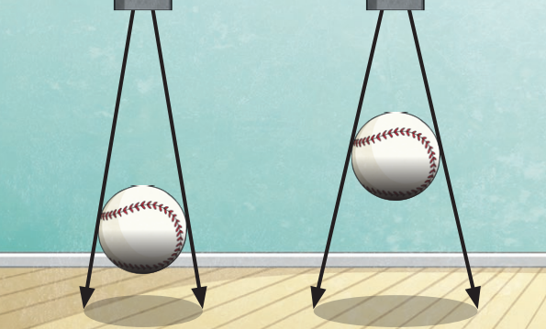
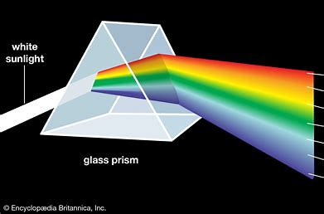
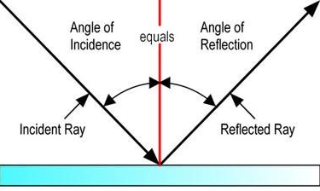
| Year 6 Knowledge Organiser Unit 1 – Science |
What is light and shadow? How do we see things?
Key Question 1: Where does light come from?
Light is a form of energy. Energy comes in different forms and can be neither created nor destroyed, only changed from one form to another.
Key Question 3: How does light get to us? How do we know how light works?
Light travels in straight lines. Many light sources give off light and heat. Hasan Ibn al-Haytham sometimes known as Alhazen - was a scientist and mathematician during early Islamic civilisation. He was the first to explain that we see objects because light reflects from objects into our eyes. Al-Haytham was an early pioneer of the scientific method which used evidence to find things out about the world.
Key Question 4: What happens when something gets in the way of light?
Light is reflected when it travels from a light source and then ‘bounces’ off an object. Sunglasses can protect eyes from sunlight but looking at the Sun directly – even with sunglasses – can damage the eyes. Everything that we can see is either a light source or something that is reflecting light from a light source into our eyes. The Sun is a light source, but that the Moon is not and is merely reflecting light from the Sun. The Sun gives off light and heat when hydrogen turns into helium. Opacity/transparency and reflectiveness are properties of a material. As objects move towards a light source, the size of the shadow Increases. Filaments in traditional bulbs heat up until they glow, giving off light and heat Fluorescent bulbs glow when electricity adds energy to a gas within the bulb.
Key question 2: Why do we need light?
We need light to see things. Pupils control the amount of light entering your eye. The retina changes light into nerves signals, sent to the brain.
Key Question 5: What happens when light travels through a material?
When light passes from one medium to another (e.g. from air to water), it changes direction; this is called refraction. When light reflects off an object, the angle of incidence is equal to the angle of reflection.
Key Question 6: What colour is light?
White light comprises all the colours of light. White light refracted by two surfaces in a prism will spread out so that all of its constituent colours can be seen; this array of colours is called a spectrum.

