Slide 1

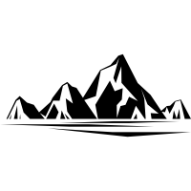
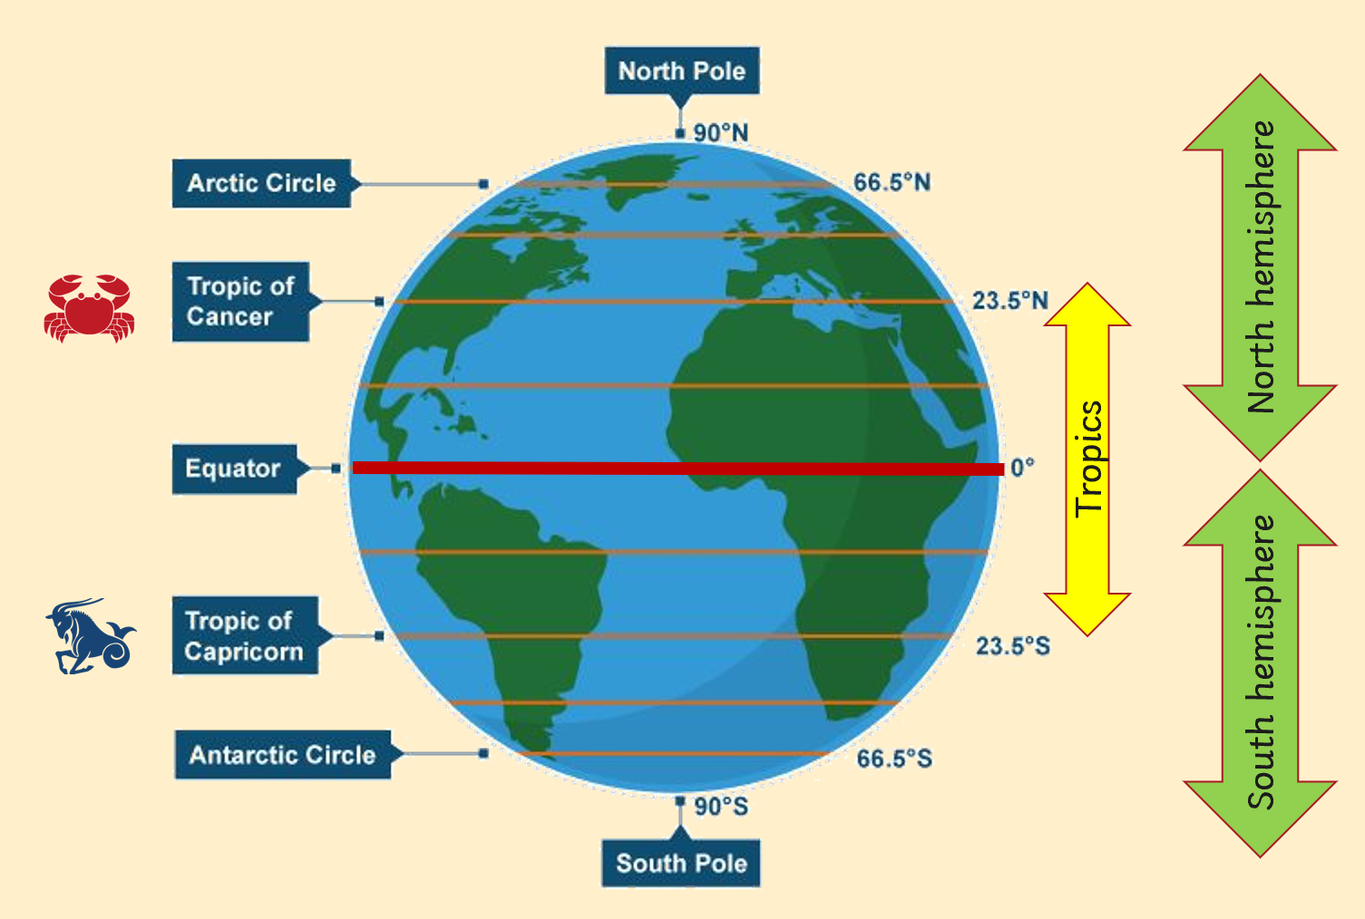
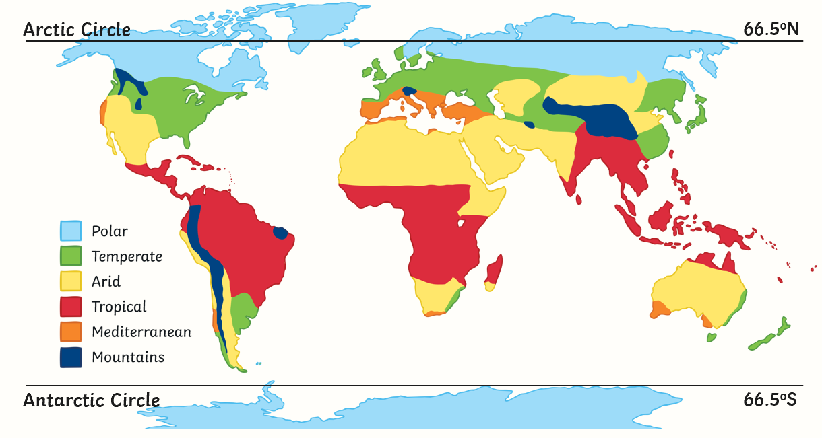
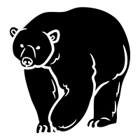
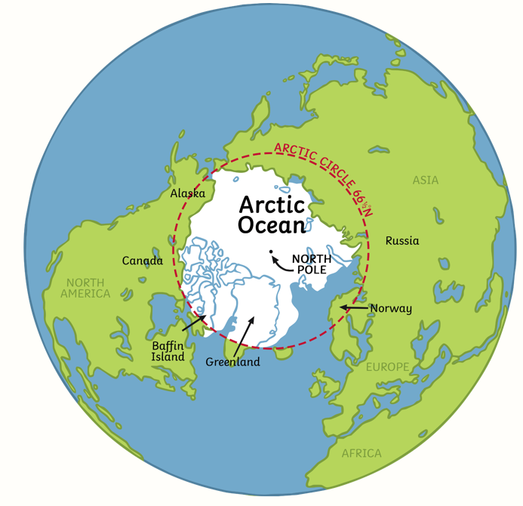

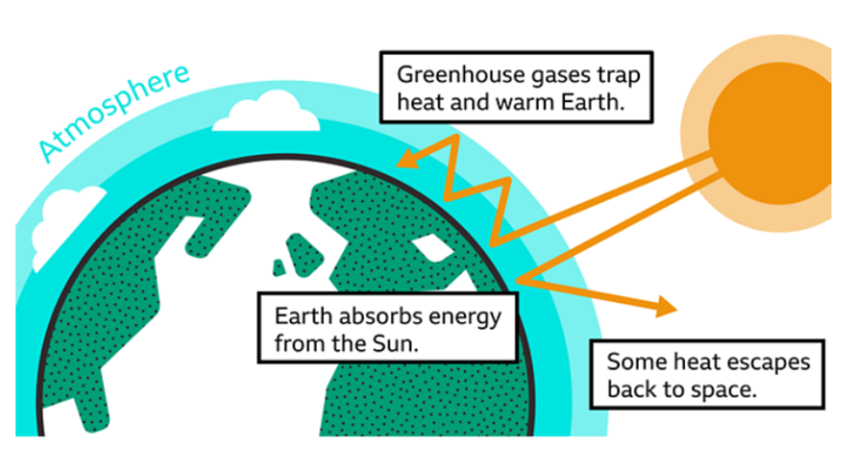
| Year 6 Knowledge Organiser – Unit 1 Geography |
Where is the North and South Pole?
Key Question 1: What is at the North and South Poles?
The polar regions extend from the North pole to the Arctic Circle at 66.5º north latitude and from the South Pole to the Antarctic Circle at 66.5º south latitude. The Antarctic is a continent because there is a land mass below the ice; the Arctic is not a continent as there is no land beneath the ice; however, the Arctic circle reaches out to include the northern part of other land masses There are deserts at the North Pole and the South Pole called the Arctic Desert and Antarctic Desert; this is because rainfall is exceptionally limited in both of these places; the Antarctic Desert is the largest Desert on Earth.
Key question 2: What is the physical environment like at the poles? What wildlife can survive there?
The polar regions are dominated by ice-sheet and tundra regions. The tundra is characterized by permafrost, a layer of soil that is frozen all year round. Animals and plants are adapted to their environment. An example of this is the Arctic fox which is adapted to its environment through: thick fur for warmth its fur that changes colour through the year its short legs and small nose and ears that ensure that less of its body is exposed to the cold
Key Question 3: Which countries have part of their land in the Artic circle?
Norway, Sweden, Finland, Russia, the United States (Alaska), Canada, and Denmark (Greenland)are the countries located in the Arctic Circle.
Key Question 4: How are the Polar regions being impacted by climate change?
The sea ice of the Arctic Ocean changes in the total area it covers through the year and that it is slowly diminishing over time as one of the major effects of climate change. This change, if it continues, will cause sea levels to rise threatening lives and major cities around the world.

