Slide 1

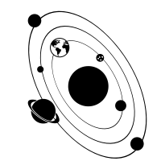
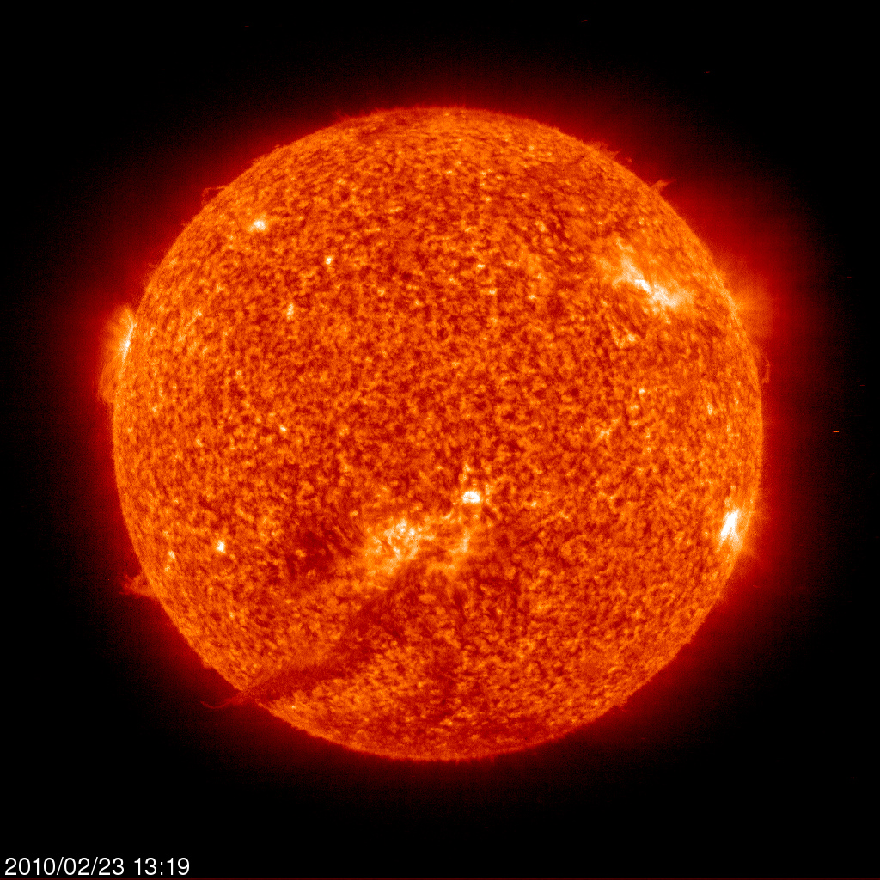


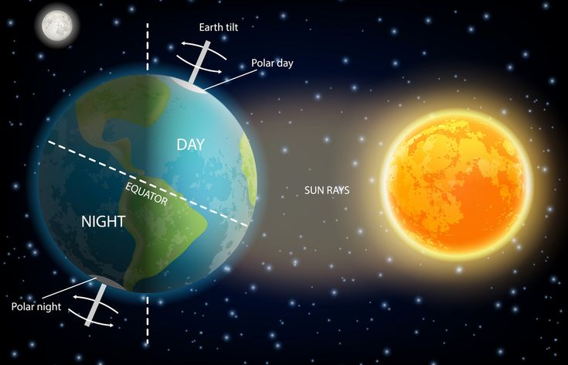
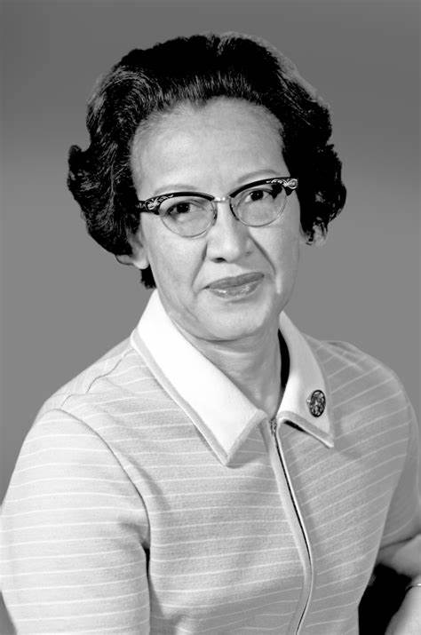
| Year 5 Knowledge Organiser – Unit 1 Science |
Earth and Space
KQ1: What’s so special about the sun?
It is a celestial body is a large object in the universe. It is a star is an exceptionally hot ball of gas, originally made from hydrogen and helium. It is the primary source of energy for us.
KQ3: What is a solar system?
The Sun and the objects that orbit it are collectively known as our Solar System. There are eight major planets in our solar system: Mercury, Venus, Earth, Mars, Jupiter, Saturn, Uranus, Neptune.
KQ2: What causes day and night?
A planet (e.g Earth) is defined as a spherical celestial body that orbits a star. Night and day are the result of the Earth rotating on its axis. The tilt of the Earth towards and away from the Sun’s light as the Earth orbits the Sun leads to the seasons. The Moon orbits the Earth roughly every 28 days. Earth orbits the Sun with one orbit constituting a year of 365/366 days. Days are longer in the summer and shorter in winter and that weather changes through the year, getting hotter in the summer and colder in the winter. The Moon orbits the Sun, different parts of it are lit up by the Sun.
KQ4: How do scientists help us to know about the solar system?
Katherine Johnson was a scientist and mathematician from America. She worked for NASA and her calculations and work were critical to the success of the first and subsequent manned space flights. She was one of the first black women to attend an integrated university in her state, West Virginia, having been handpicked due to her ability.

