Slide 1
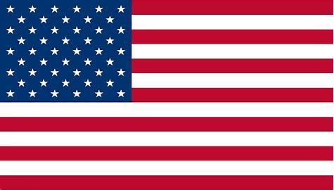
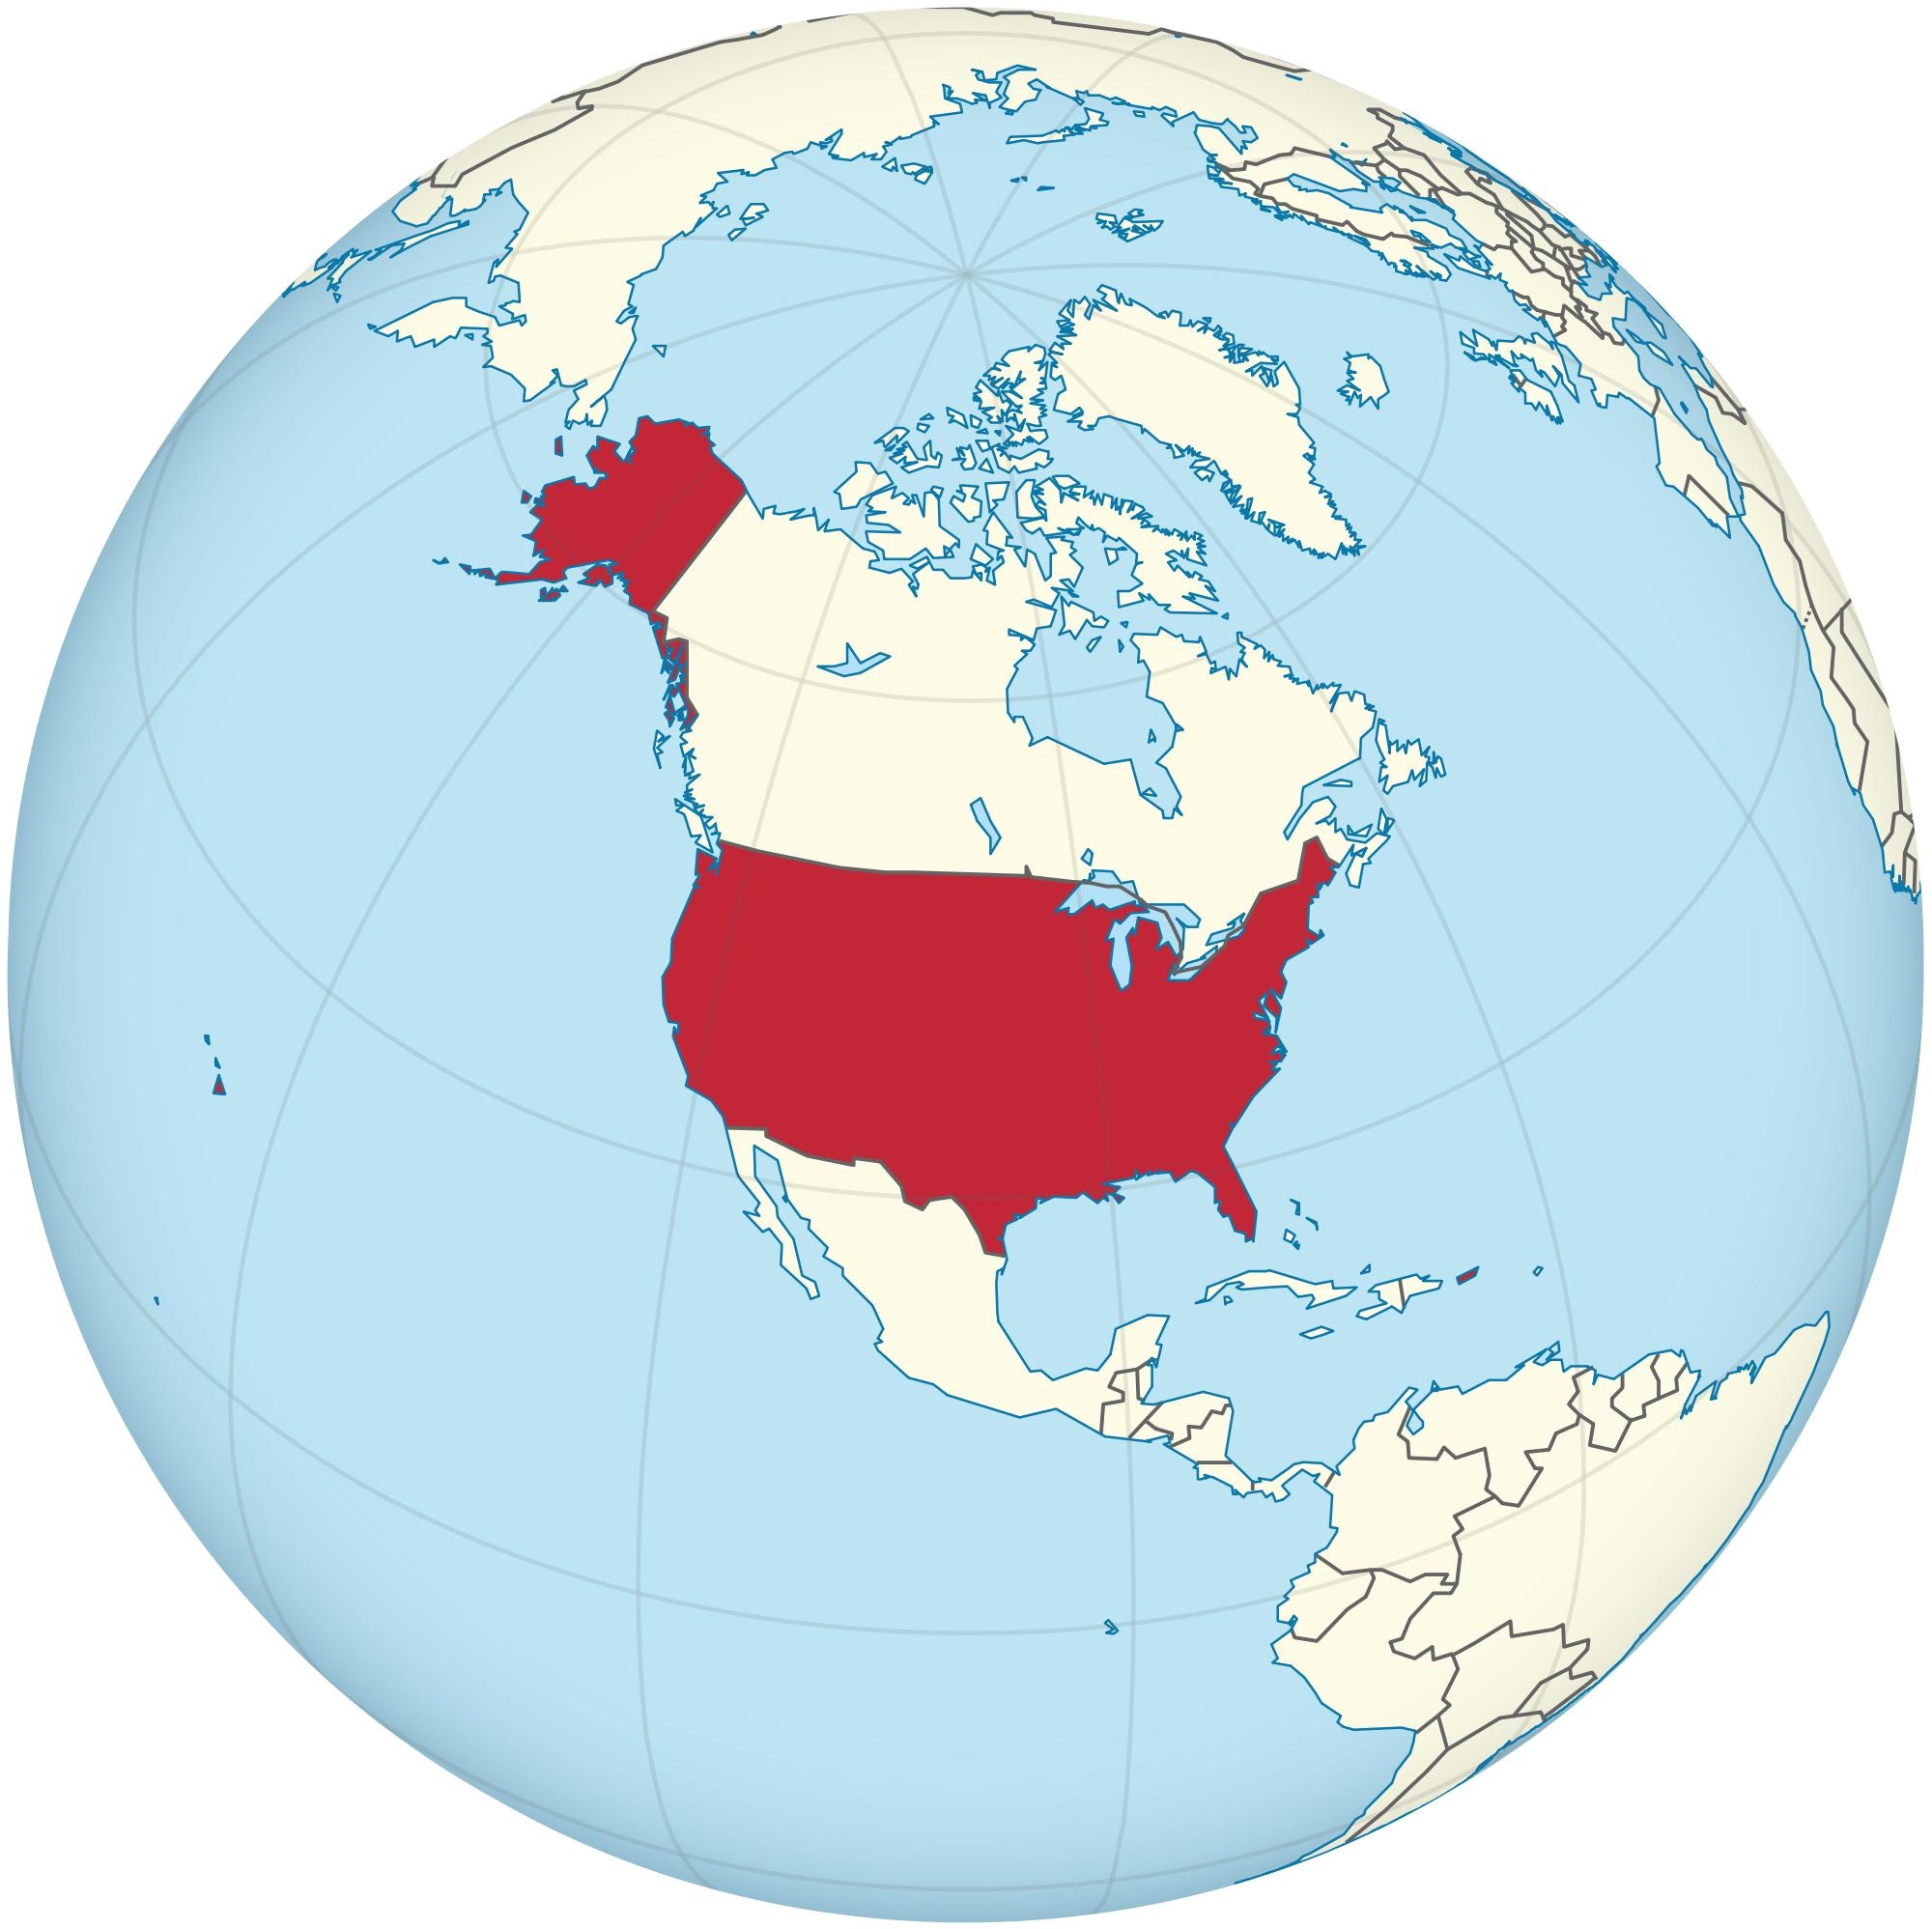
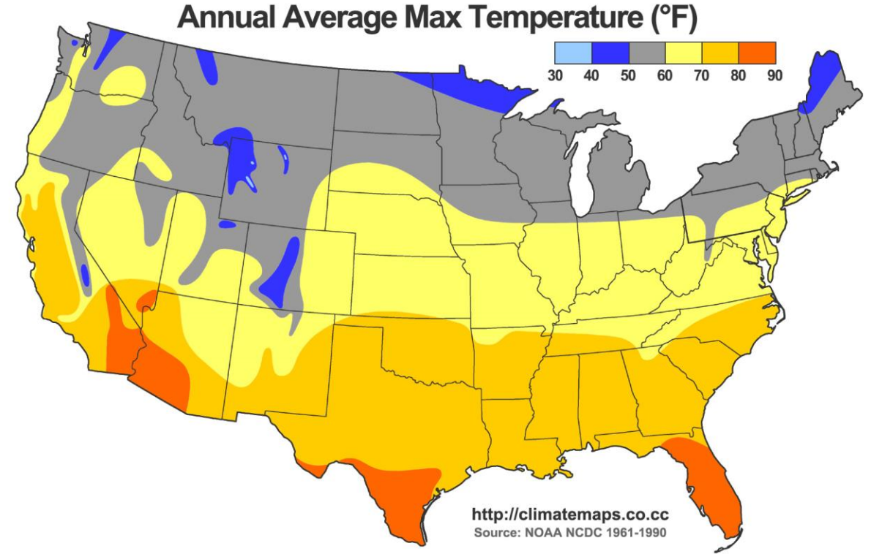
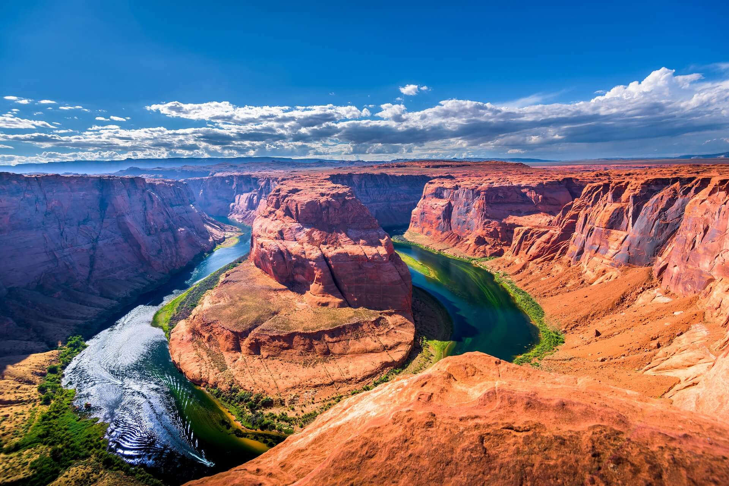
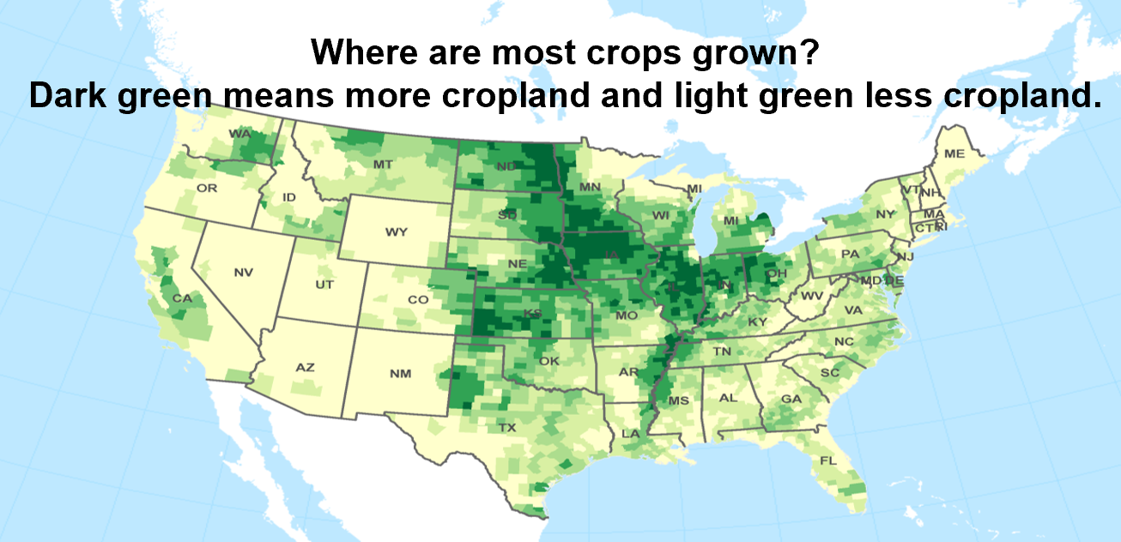


| Year 4 Knowledge Organiser – Unit 1 Geography |
Is everywhere the same? How does Blaby compare to somewhere else in the world?
KQ1: What is the United states of America?
The United States of America (USA) within the continent of North America. There is a land border with Mexico to the South and Canada to the north. Washington DC is the capital city of the United States and that New York is the most populous city in the USA. The USA has the Atlantic Ocean to the east of the country and the Pacific Ocean to the west.
KQ4: Why does the climate vary across the USA?
KQ5: What foods are exported from the USA and do they all grow in the same place?
KQ2:What are the key physical features of the USA?
The Grand Canyon is a famous physical feature in the USA.
KQ3: How is the population distributed in the USA?
Urban areas = towns and cities, are densely populated Rural areas = not as populated with fewer buildings and amenities, and have farmland and countryside
KQ6: How does New York compare with Blaby?
New York is similar to many cities. Blaby is a village. New York has a much larger population to Blaby.

