Slide 1




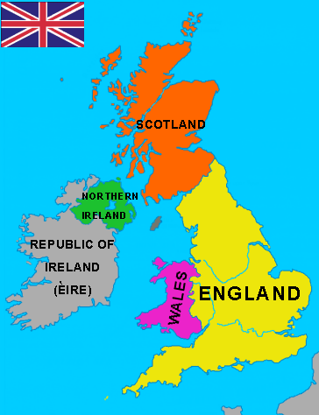
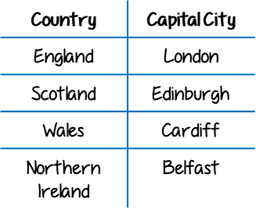

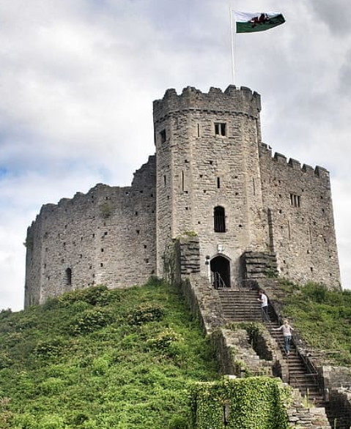
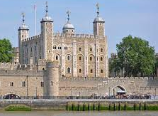
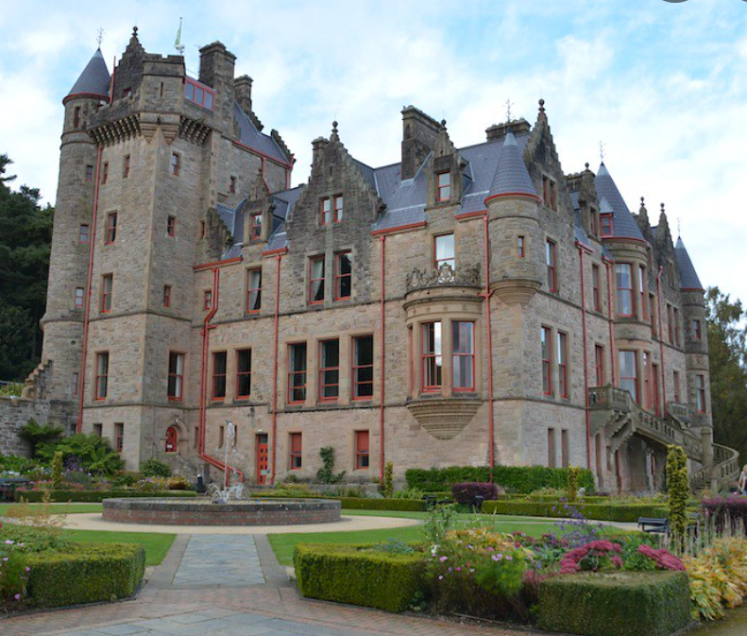
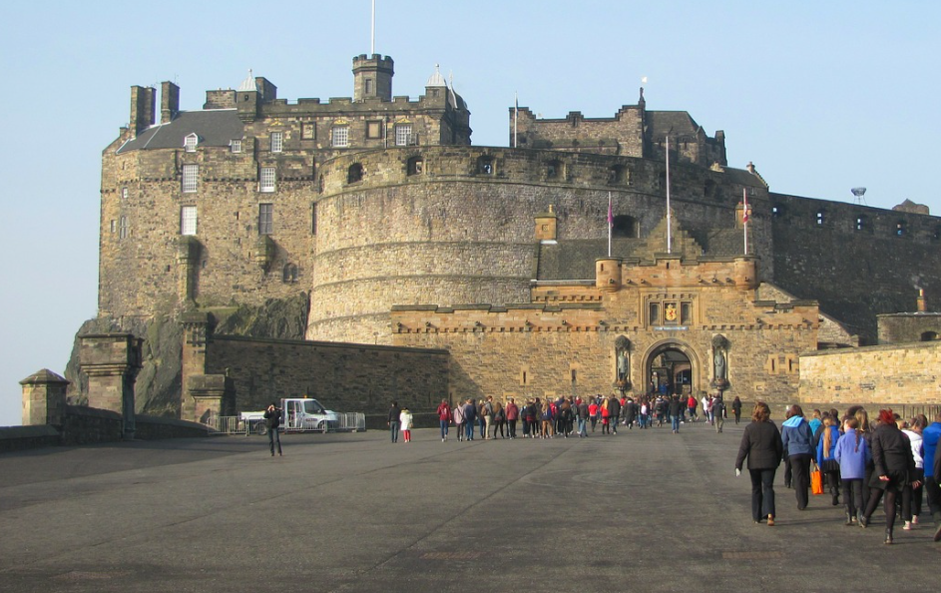
| Year 2 Knowledge Organiser – Unit 1 Geography |
What is a capital city and why do they have big roads going to them and special buildings in them?
KQ1: How can we make maps of Our area?
An aerial photo is a photograph from above. Photos from above help people draw maps accurately.
KQ4: Why do we have capital cities and is there anything special about where they are located?
Capital cities were established because they were near good trade routes, particularly ports.
KQ2: What is the United Kingdom?
KQ3: What are the capital cities in the United Kingdom?
KQ5: Why is it important to be able to get to a capital city?
Roads and railways and canals are man-made features that support travel to and from a capital city.
KQ6: Why do capital cities have castles or other important buildings in them?
Edinburgh Castle
Cardiff Castle
Tower of London
Belfast Castle

