Slide 1

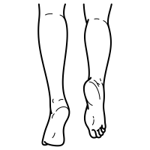









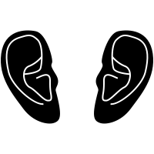










| Year 1 Knowledge Organiser – Unit 1 Science |
How are humans different to insects in the way we live and grow??
KQ1: What’s my body like and what can it do?
Human body parts: feet, legs, arms, hands, torso, head, skin, ears, eyes, nose, mouth and tongue
KQ3: How do scientists classify different types of animals?
We have mammals, fish, amphibians, birds and reptiles.
KQ2: Are all animals the same?
Animals are different structures eg wings, tails, ears. They have different skin coverings.
KQ4: How do plants and animals help each other to live?
Energy transfers between plants and animals when animals eat plants. Herbivorous eat plants Carnivorous eat other animals Omnivorous eat both animals and plants

