Slide 1
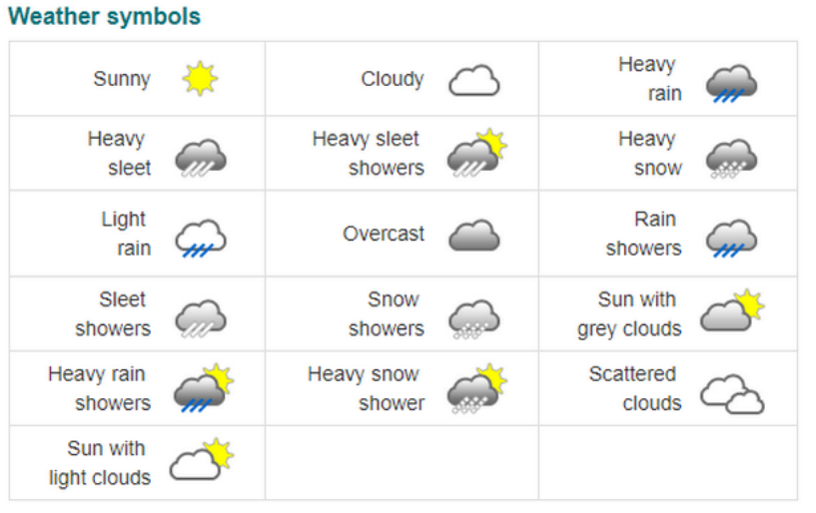
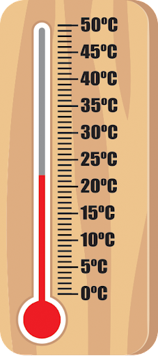
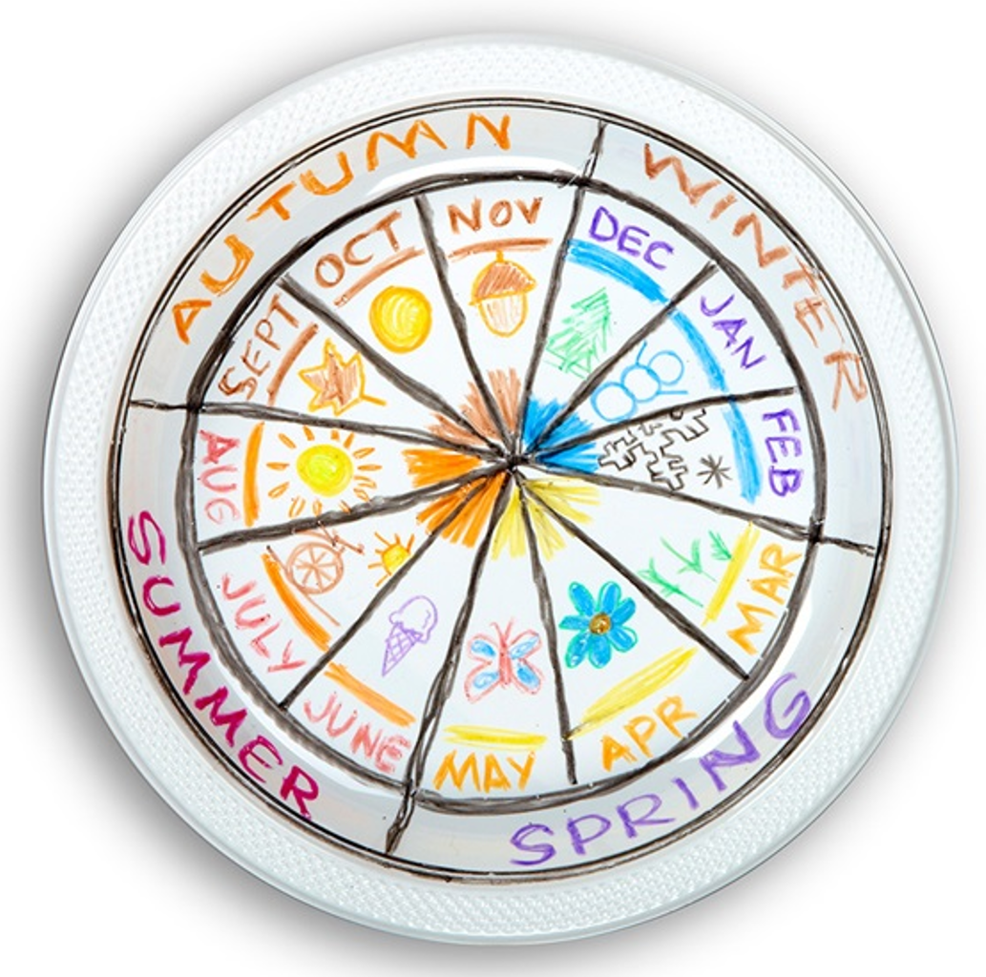
| Year1 Knowledge Organiser – Unit 1-6 Science |
The seasons
KQ1: What is the weather?
KQ3: How do we measure temperature?
This is a thermometer. We can use this to measure the temperature.
KQ2: What are the seasons?

