Slide 1
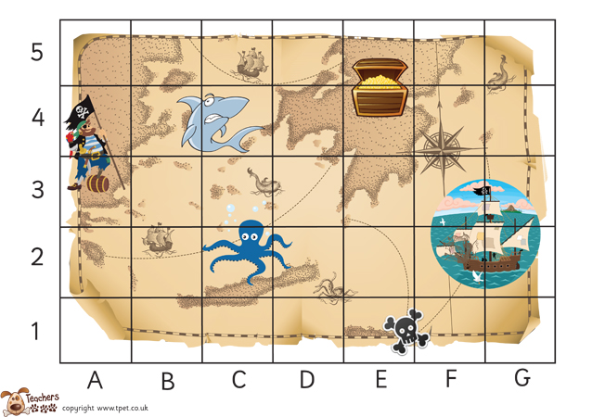
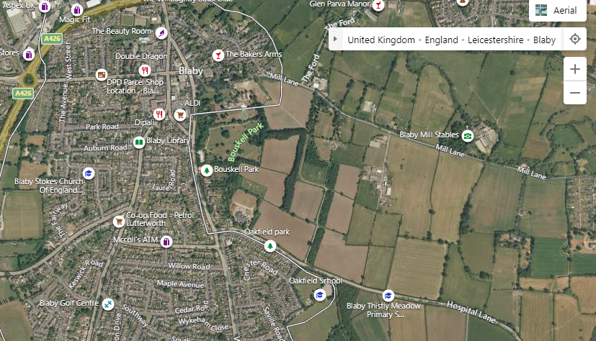
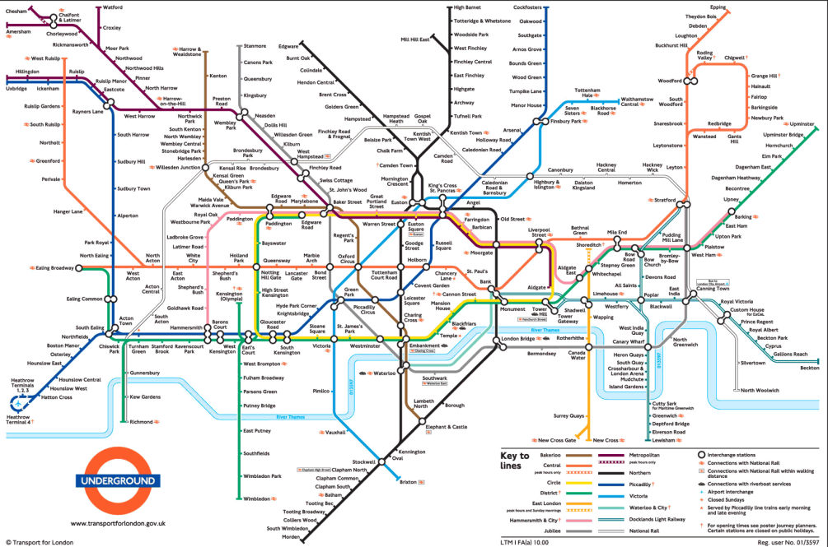
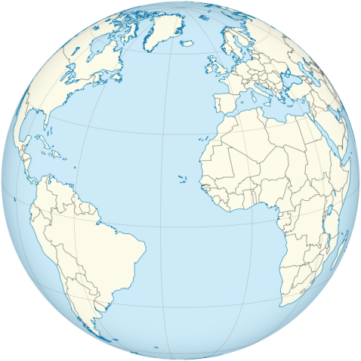
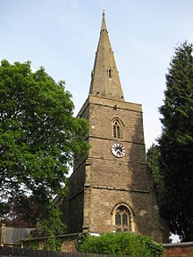
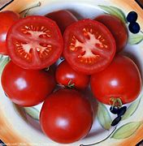
| Year Knowledge Organiser – Unit 1 Geography |
Where do I live?
Key Question 1: What is a map?
KQ3: How can I record what I know about Blaby on a map? What ways have other people recorded it?
KQ4: What is a landmark?
A landmark is a distinctive and memorable feature in a place
KQ5: Has the school always been the same and why were any changes made?
There used to be a tomato farm on Blaby Stokes School.
Key Question 2? What is the place called Blaby like? What are the different spaces and how are they used?
Blaby has grown bigger over the years.

